Slide 1












THE WEDDING AT CANA

Slide 2


INTRODUCTION
Who has been to a wedding before?
What was it like?
What if food or drink ran out?
Notes:
Ask the children:
Who has been to a wedding before?
What was it like?
What if food or drink ran out?

Slide 3


PICTURES OF
WEDDING CELEBRATION
FROM ALL OVER
Notes:
People celebrate their wedding in so many different ways... We are going to start by looking at some wedding pictures from all over... Are you ready?

Slide 4
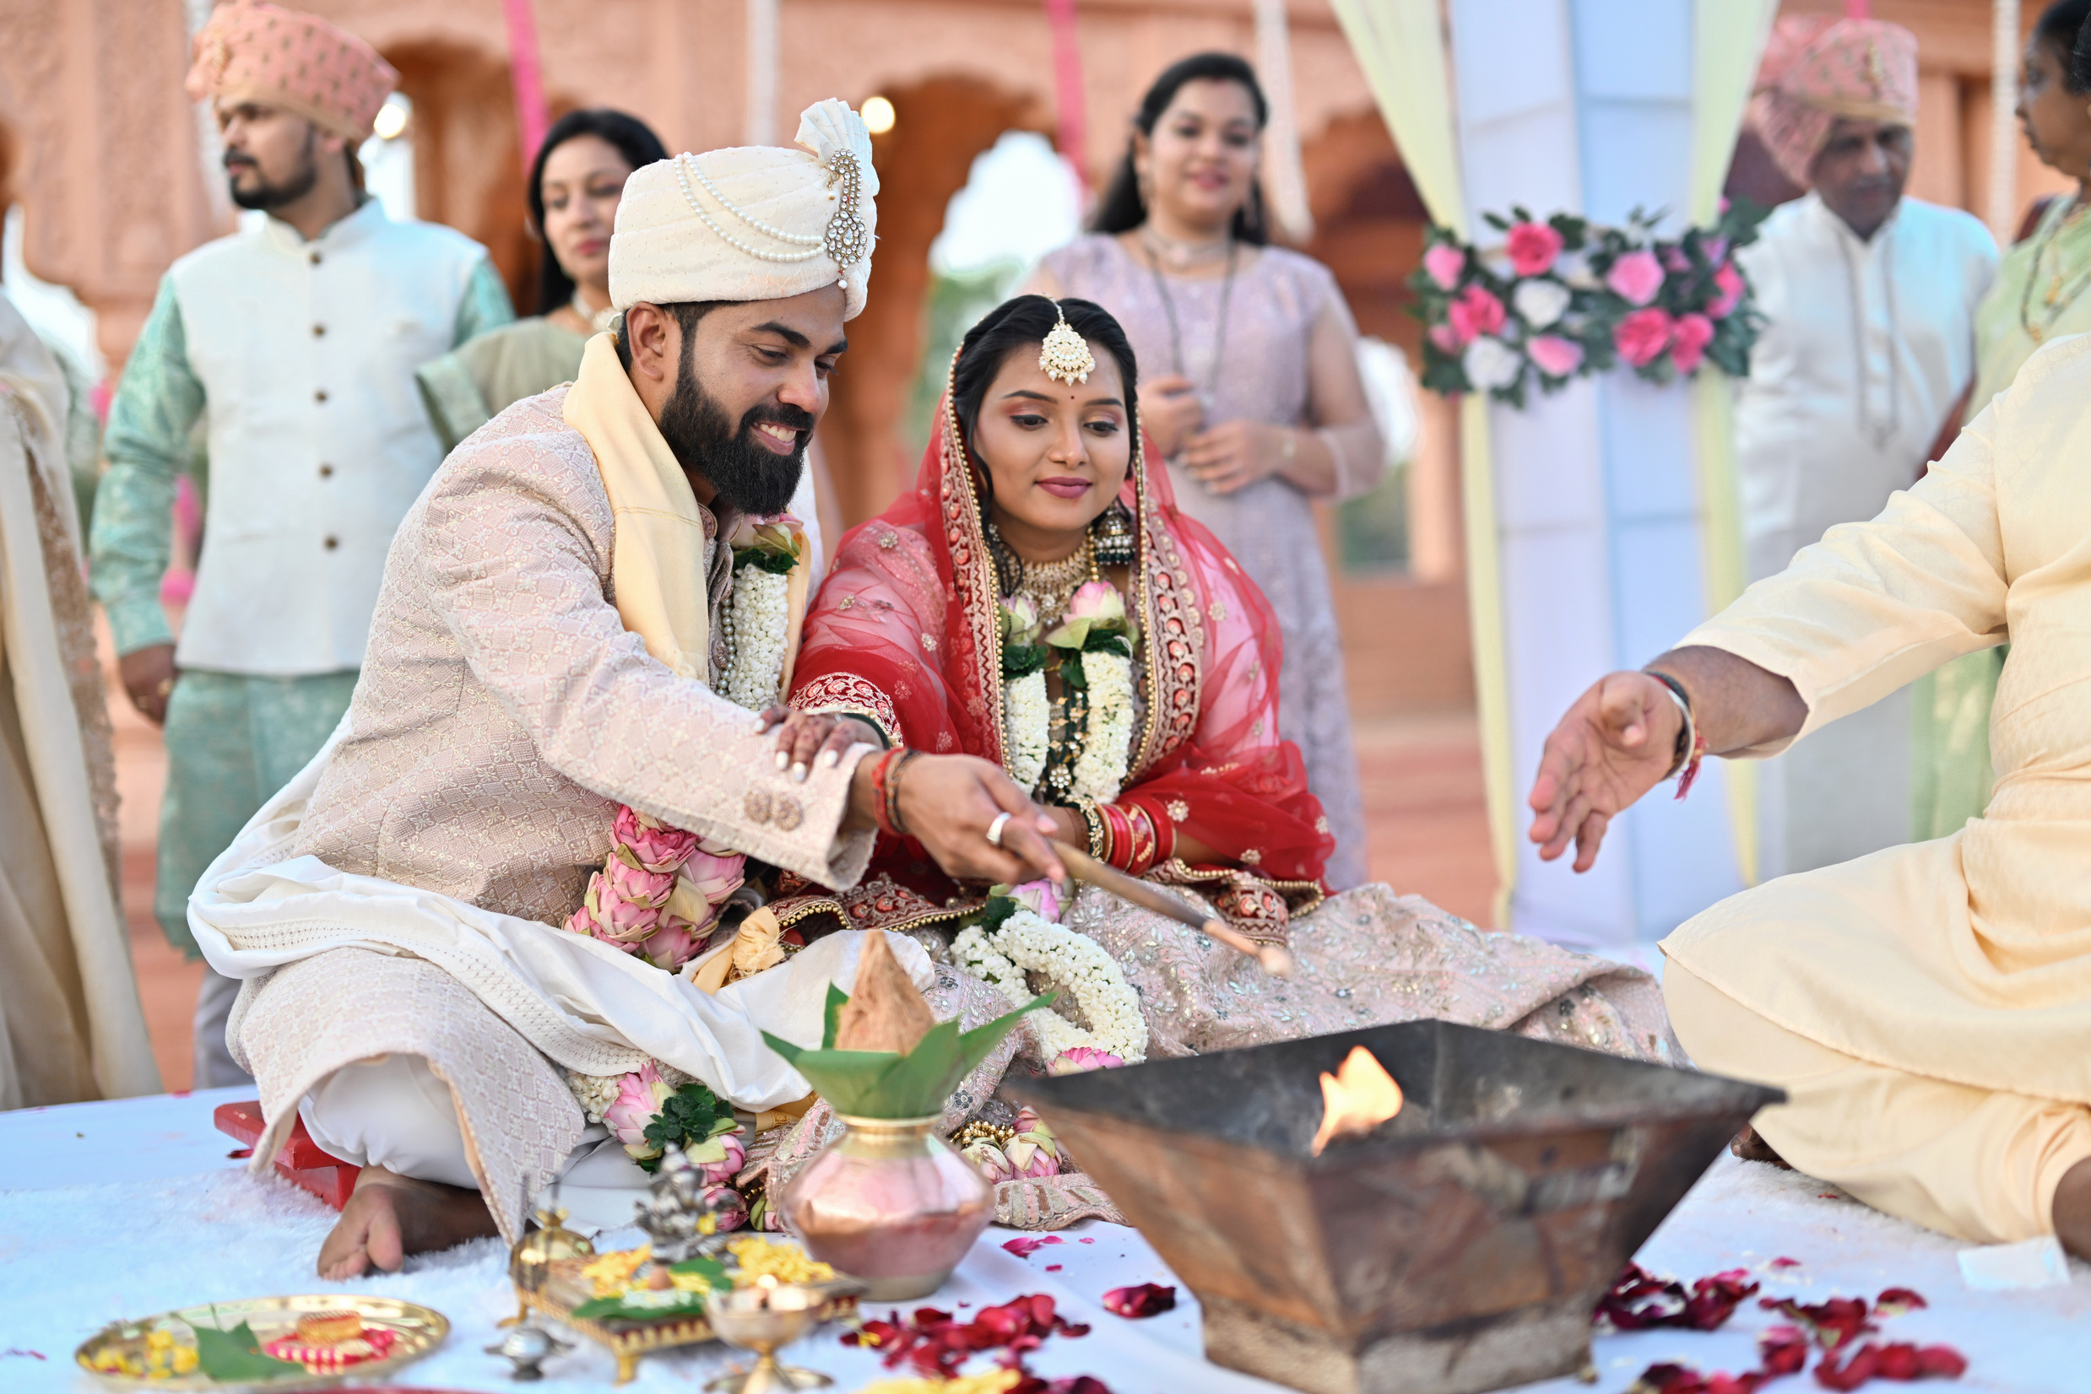

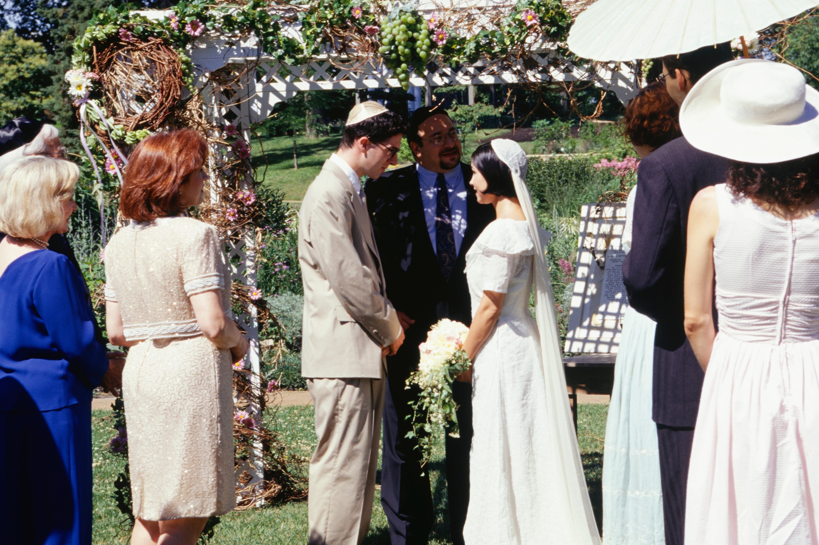
DIFFERENT OUTFITS
Notes:
Different outfits:
Where do you think these couples are from?

Slide 5
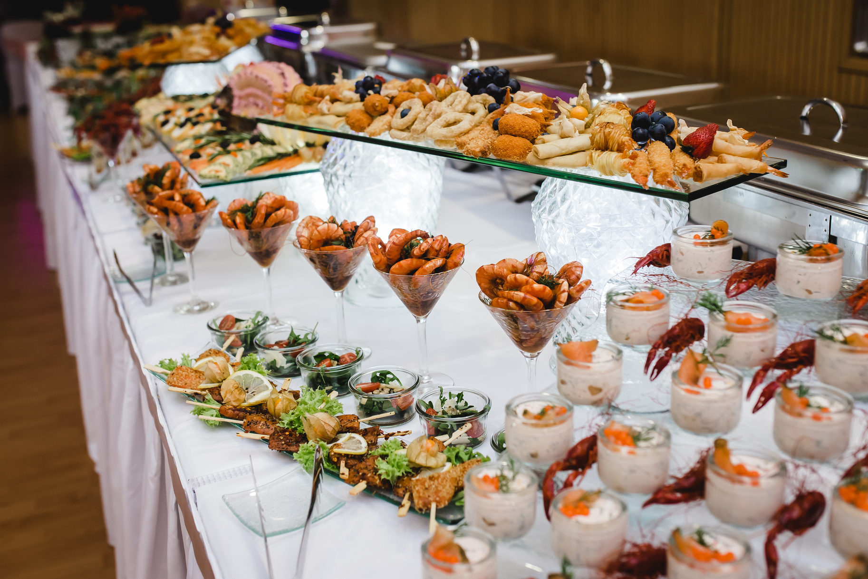
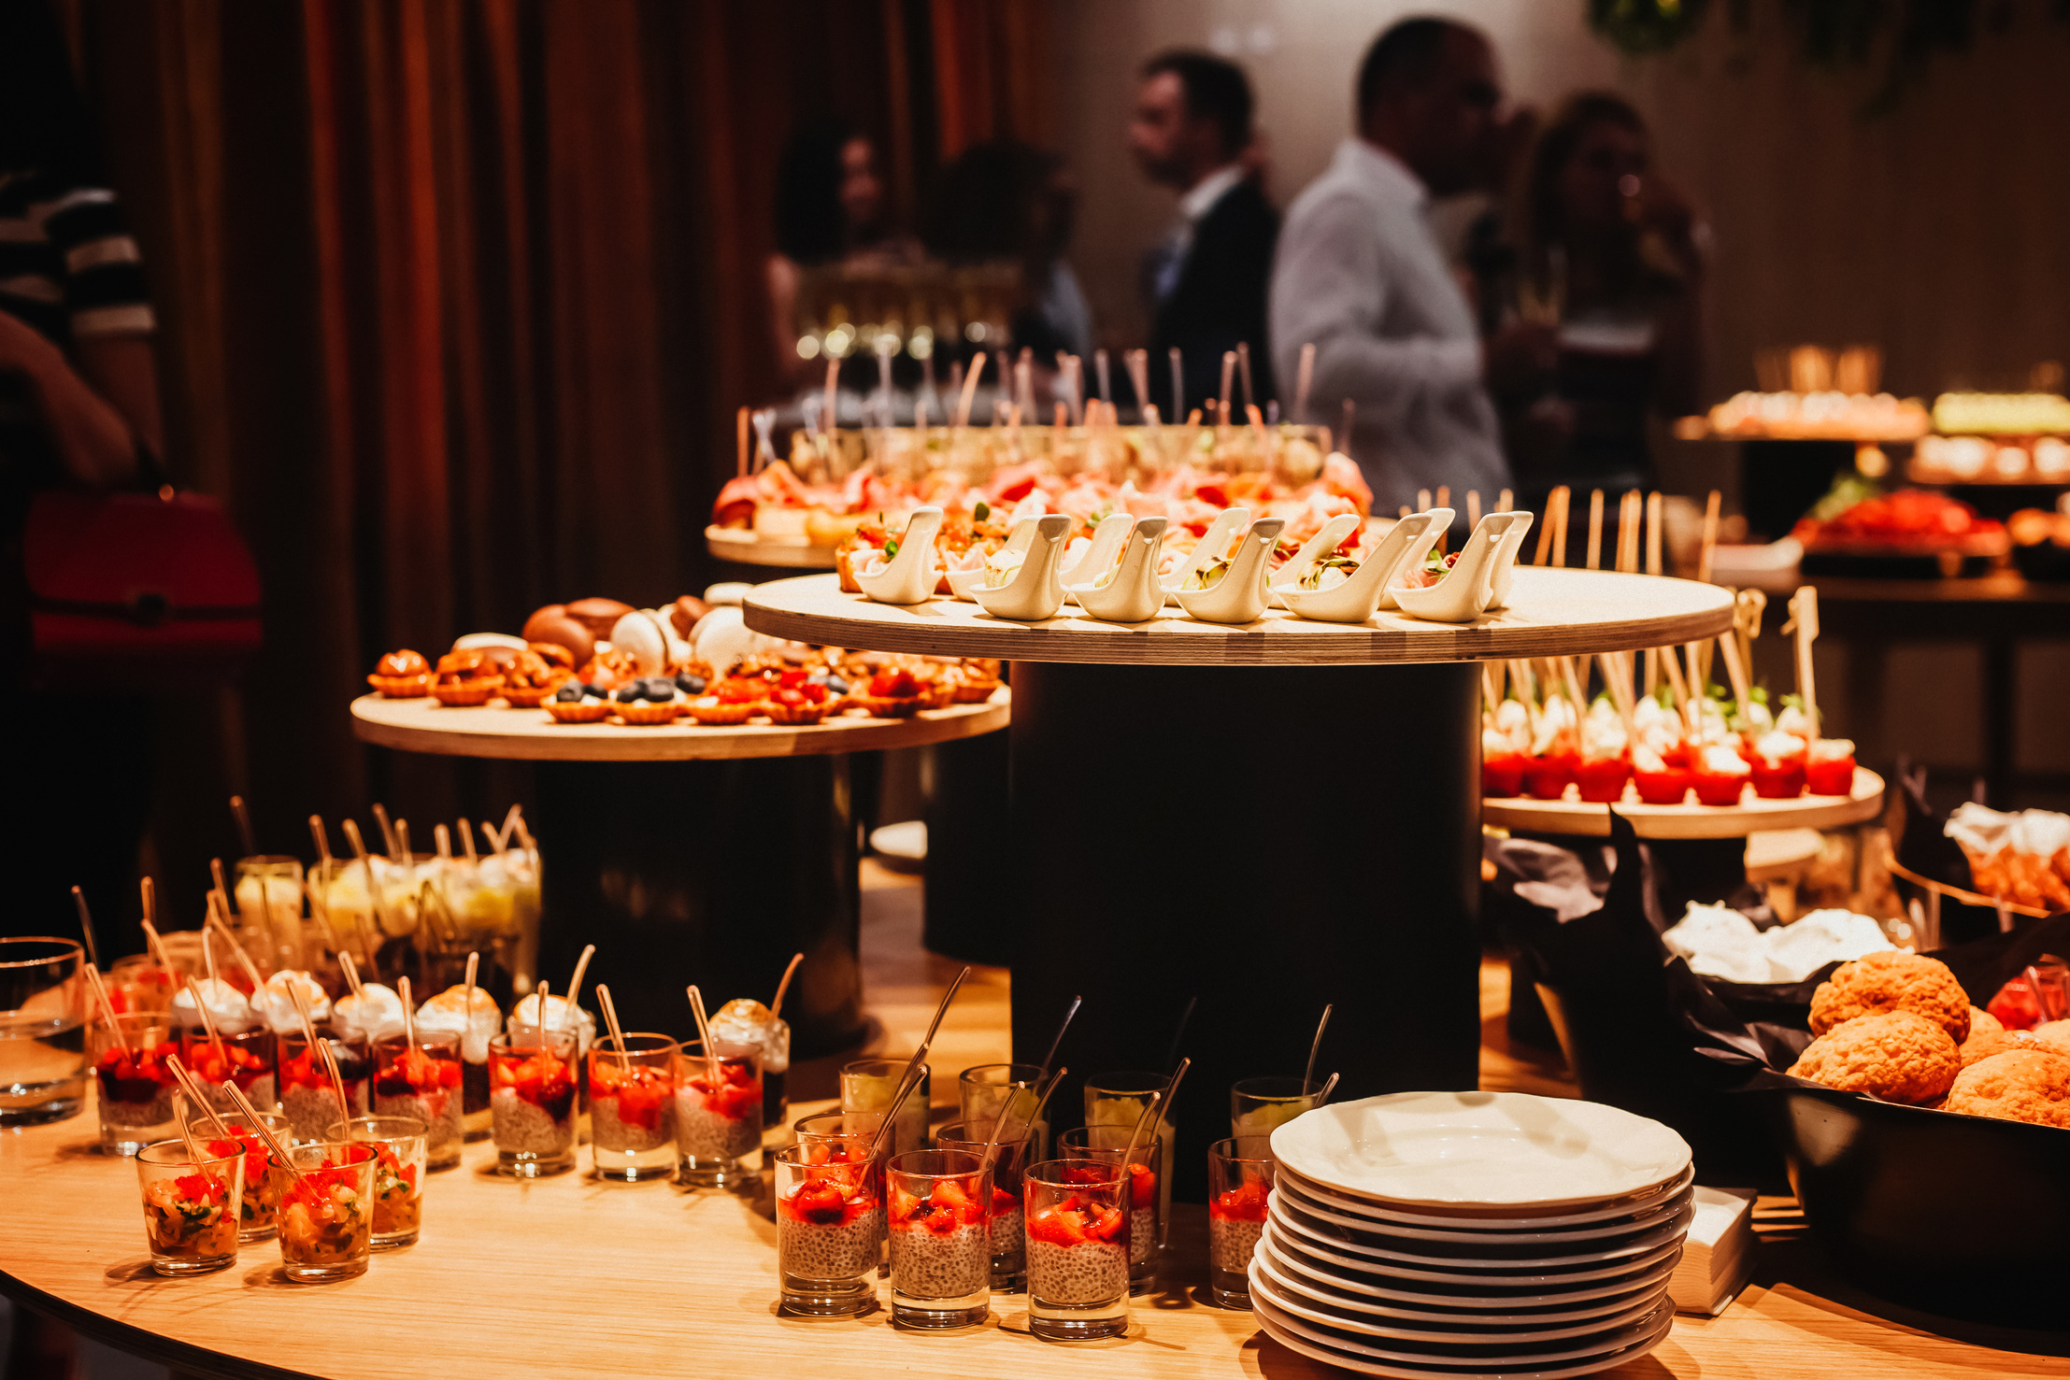
DELICIOUS FOOD
Notes:
A weddings we often eat delicious food...

Slide 6
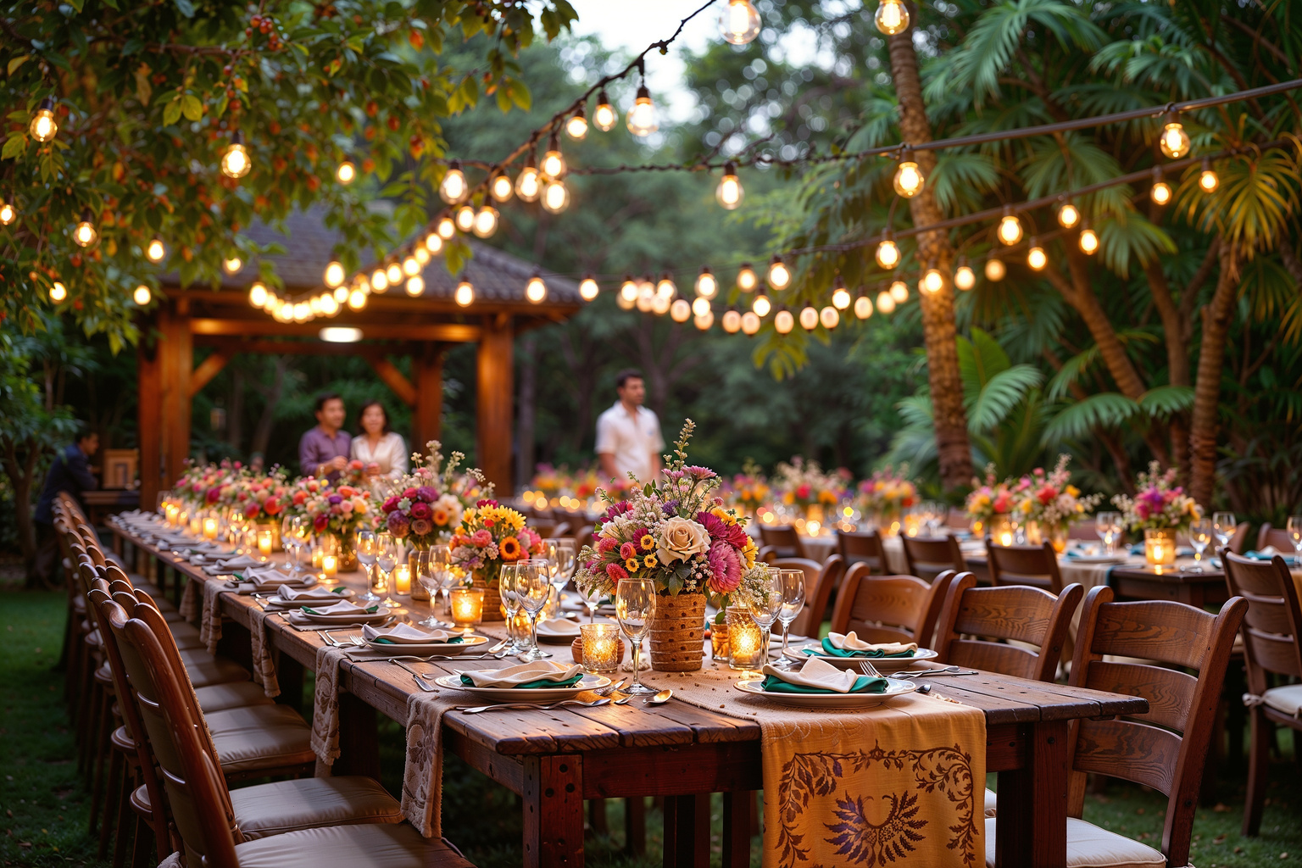
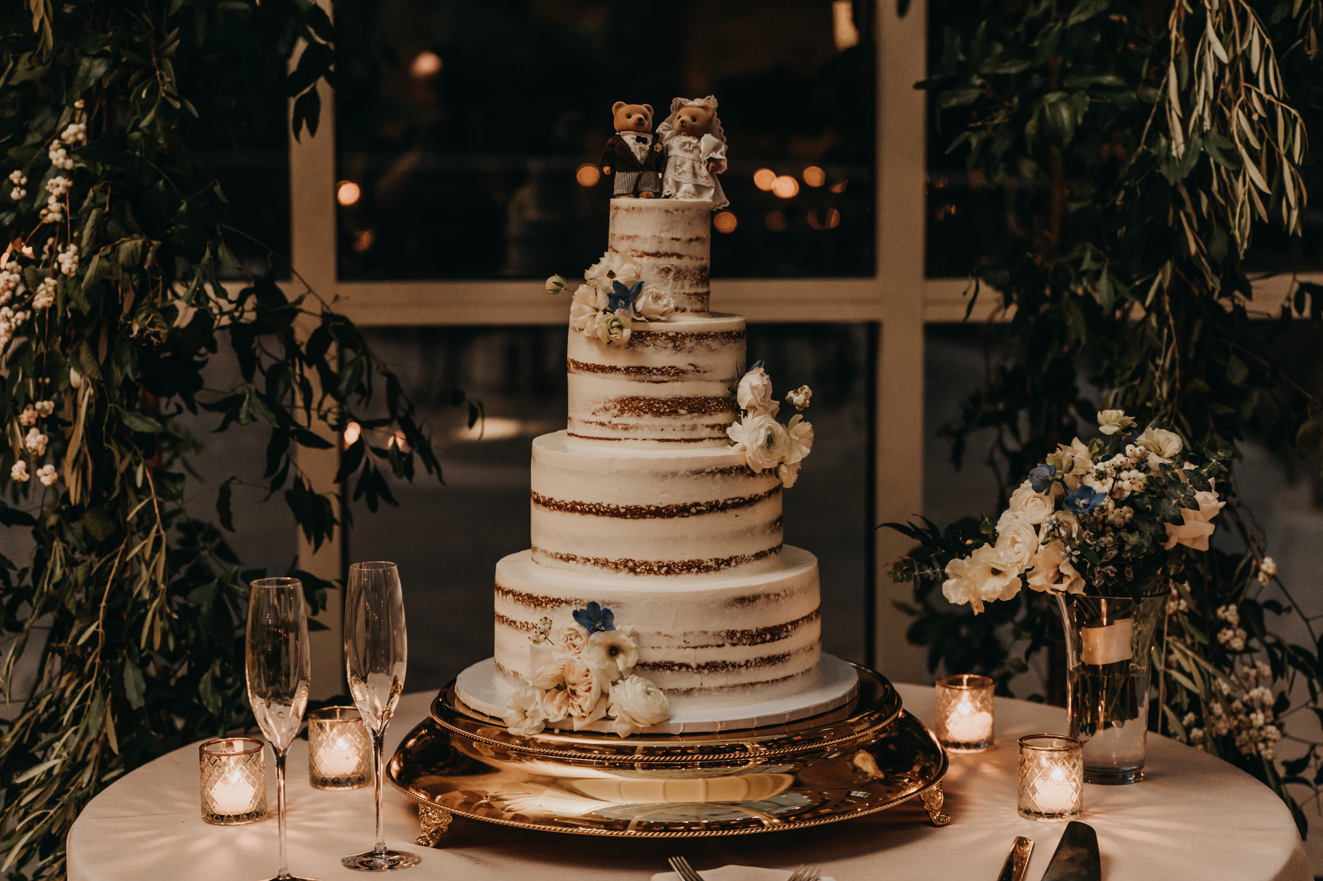

DECORATION
CAKE!
Notes:
Cool decorations, yummy cakes

Slide 7

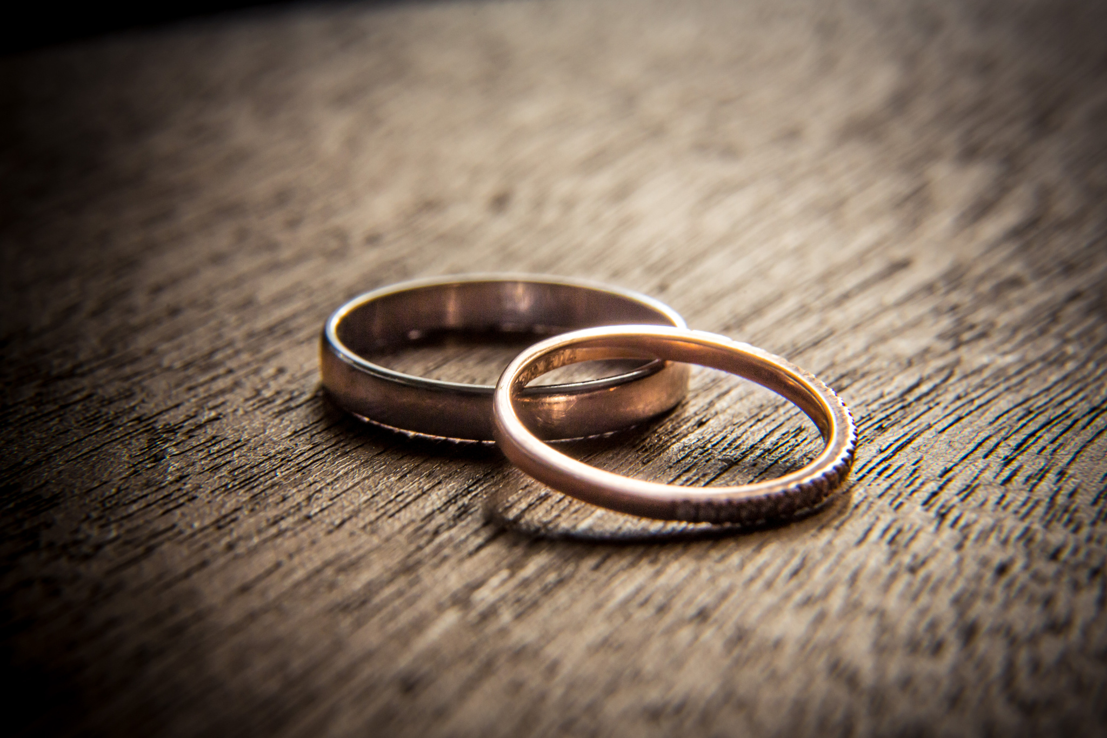

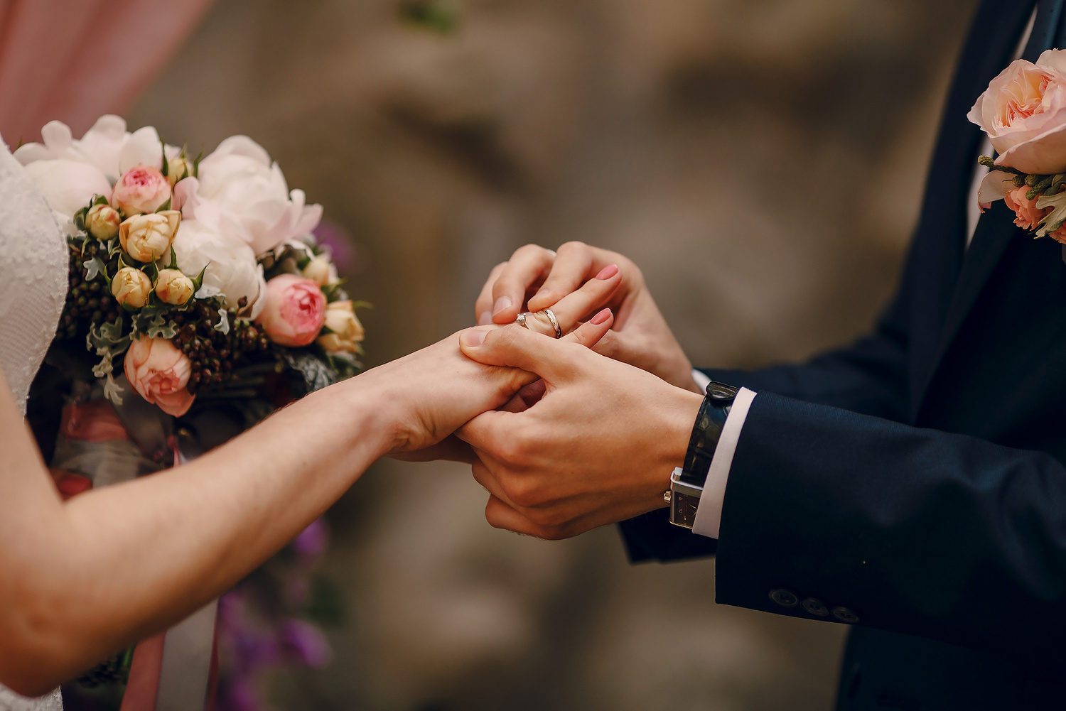

EXCHANGE RINGS
Notes:
When they get married, people exchange rings...

Slide 8
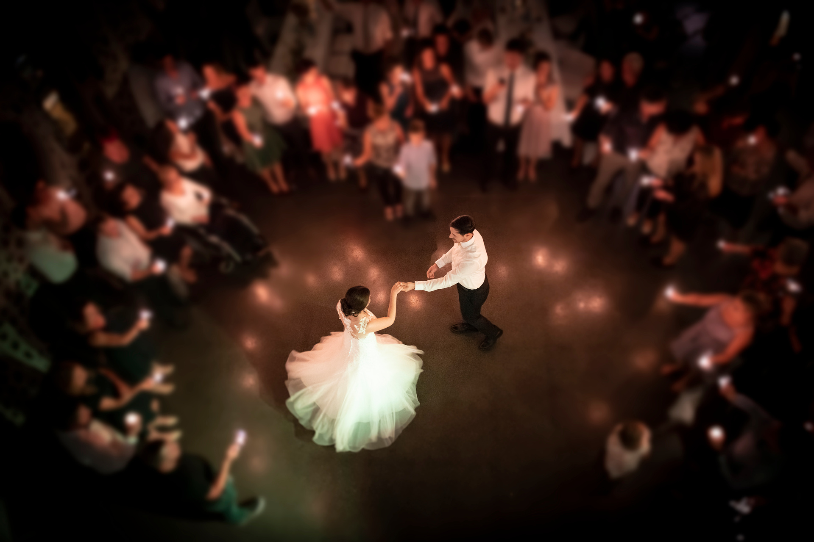
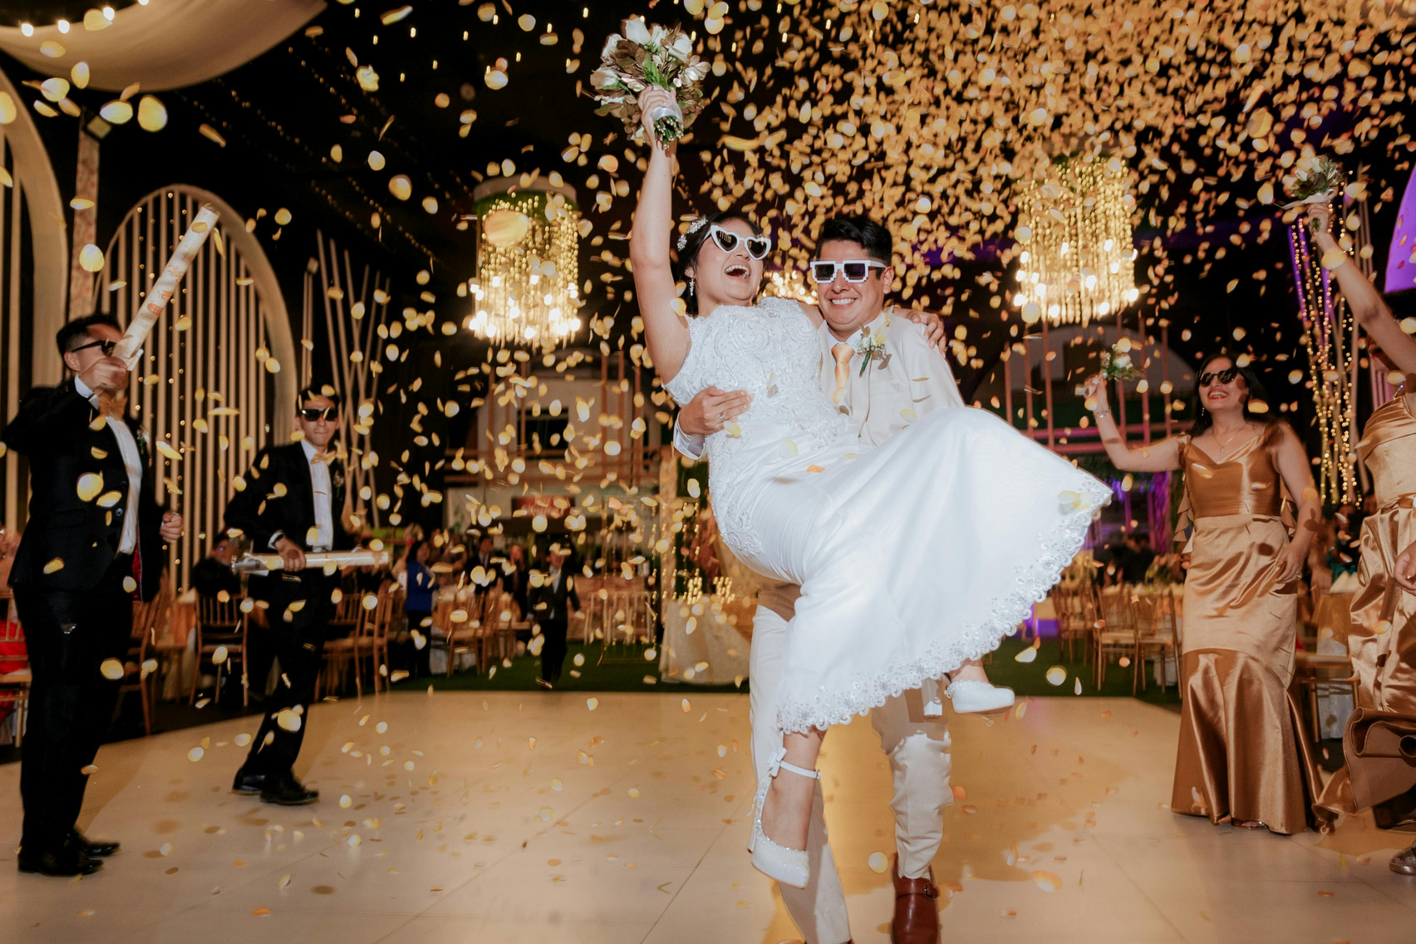
DANCE
Notes:
They dance...

Slide 9
TODAY WE’RE LEARNING ABOUT JESUS’ VERY FIRST MIRACLE!
It happened at a wedding party in a town called Cana. Weddings in Bible times were huge celebrations that could last for days!
Notes:
Today we’re learning about Jesus’ very first miracle!
It happened at a wedding party in a town called Cana. Weddings in Bible times were huge celebrations that could last for days!
Optional (BUT FIRST WE PLAY A GAME) - Toilet Paper Wedding Dress Challenge

Slide 10

BIBLE READING
John 2:1-12 (New International Version)
Jesus Changes Water Into Wine
2 On the third day a wedding took place at Cana in Galilee. Jesus’ mother was there, 2 and Jesus and his disciples had also been invited to the wedding. 3 When the wine was gone, Jesus’ mother said to him, “They have no more wine.”
4 “Woman,[a] why do you involve me?” Jesus replied. “My hour has not yet come.”
Notes:
Optional: Let the children read
Or the leader reads it
Or skip to slide 14
Comment on highlighted sentences: Jesus had friends who invited him to a wedding party!

Slide 11


5 His mother said to the servants, “Do whatever he tells you.”
6 Nearby stood six stone water jars, the kind used by the Jews for ceremonial washing, each holding from twenty to thirty gallons.
7 Jesus said to the servants, “Fill the jars with water”; so they filled them to the brim.
8 Then he told them, “Now draw some out and take it to the master of the banquet.”
Notes:
Mary knew something in her heart... she raised Jesus!
Comment: Jars used for ceremonial washing: being clean through the law and religious rituals vs new wine: Jesus's blood - we are cleansed by grace through our faith in him!

Slide 12
They did so, 9 and the master of the banquet tasted the water that had been turned into wine. He did not realize where it had come from, though the servants who had drawn the water knew. Then he called the bridegroom aside 10 and said, “Everyone brings out the choice wine first and then the cheaper wine after the guests have had too much to drink; but you have saved the best till now.”

Slide 13

11 What Jesus did here in Cana of Galilee was the first of the signs through which he revealed his glory; and his disciples believed in him.
12 After this he went down to Capernaum with his mother and brothers and his disciples. There they stayed for a few days.

Slide 14
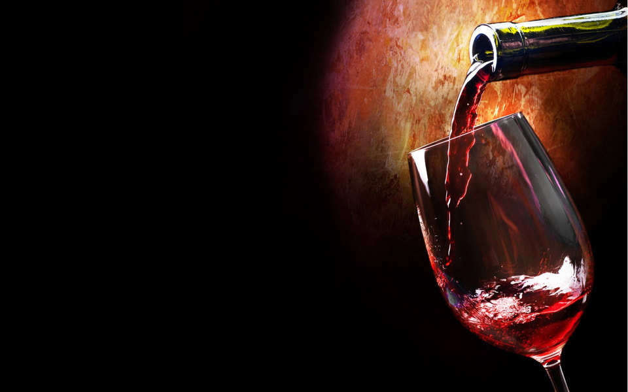

THE PROBLEM
The host ran out of wine! That was embarrassing and would spoil the celebration.
Oh No! They Ran Out of Wine!
Notes:
OK- so, what was the problem? At the party, something very embarrassing happened. The wine ran out! In those days, this was a disaster for the family—it made them look unprepared and dishonoured the guests.

Slide 15

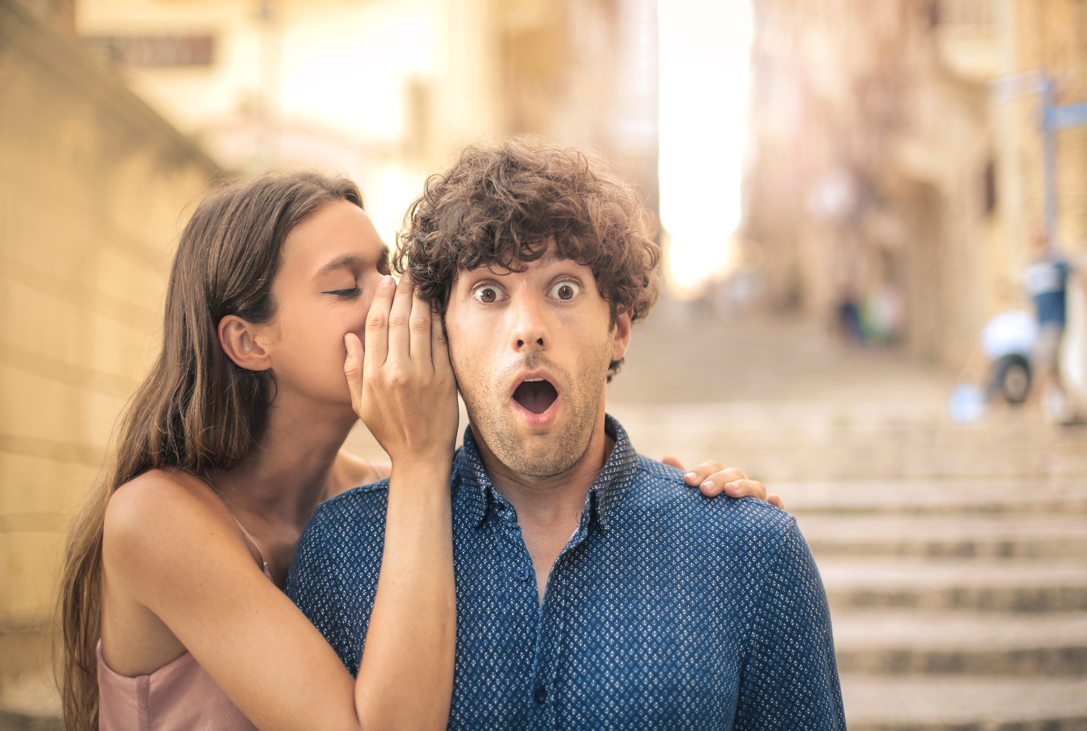



MARY TOLD JESUS
Mary believed Jesus could help. She said, ‘Do whatever He tells you.’ That’s good advice for all of us!
They ran out of wine!
Notes:
Mary trusted Jesus completely. She told the servants to do exactly what He said. Even though He hadn’t done a public miracle yet, she knew He could handle it.”

Slide 16
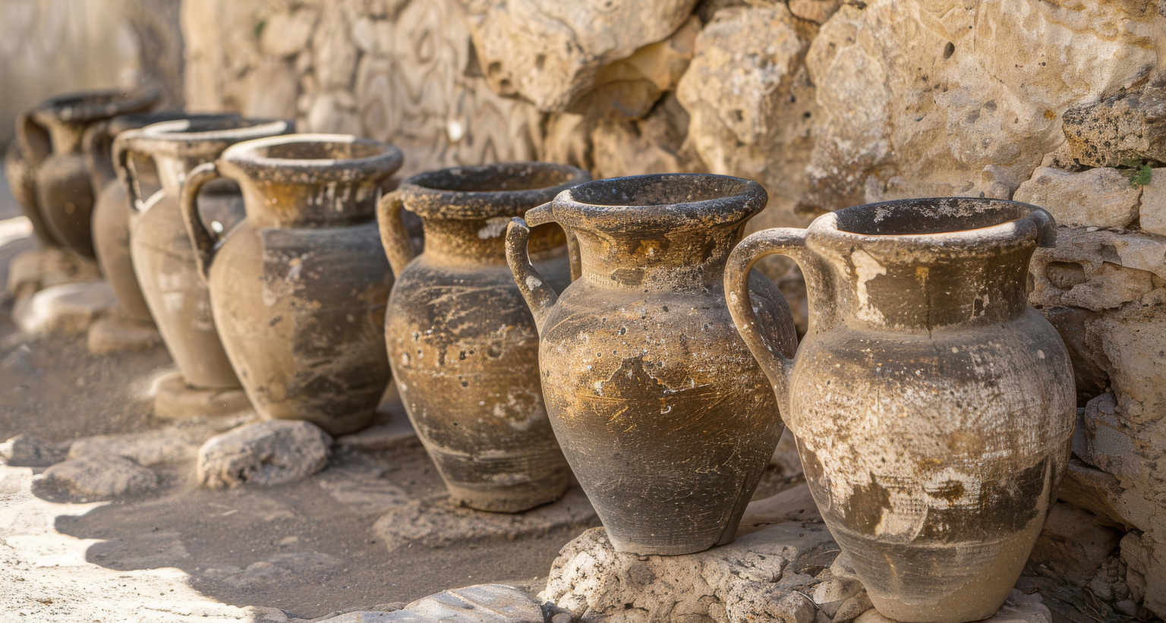
SIX STONE JARS
Notes:
Nearby were six huge stone jars, normally used for washing before meals. Jesus asked the servants to fill them with water—all the way to the brim!”

Slide 17
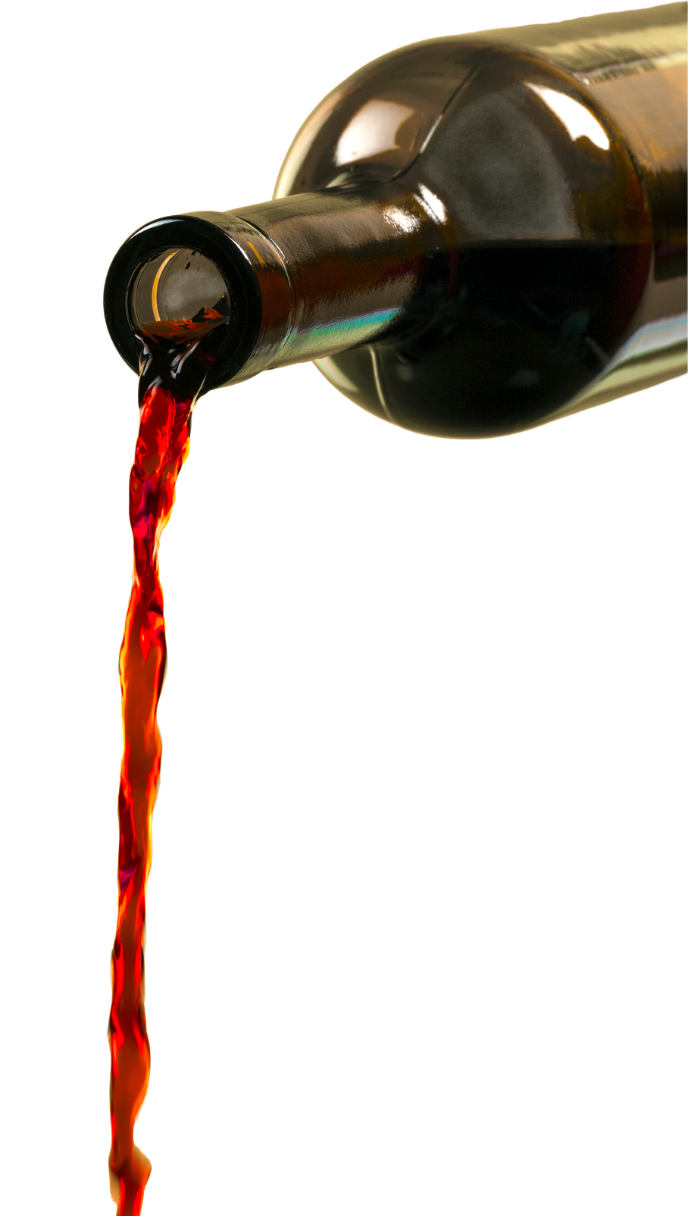

THE MIRACLE
When the servants drew some water and gave it to the master of the banquet, it wasn’t water anymore—it had turned into wine! Not just any wine, but the best wine anyone had tasted.
You saved the best until now!
Notes:
When the servants took some water to the master, it wasn’t water anymore — it was wine! Jesus had done a miracle!

Slide 18


WHAT IS A MIRACLE?
A miracle is when something impossible happens...
but with God it becomes possible.
Notes:
This wasn’t a trick or magic—it was a miracle! Only God could make water become wine instantly. Miracles show God’s power and help us trust Him more.”

Slide 19
THE LESSON
Miracles show Jesus’ glory.
His disciples believed in Him. (John 2:11)
Notes:
The Bible says this was the very first miracle Jesus did. It revealed His glory—showing who He really is—and it made His disciples believe in Him even more.”

Slide 20


APPLICATION
What can we learn?
Trust Jesus like Mary
Obey Him like the servants
Believe in Him like the disciples
Notes:
“The Wedding at Cana reminds us: We can trust Jesus with our problems, obey Him even if it seems small or silly, and believe that He is God’s Son who can do the impossible.”

Slide 21
DISCUSSION QUESTIONS
Why do you think Mary told Jesus about the problem?
Why was running out of wine a big deal at a wedding?
What do you think the servants felt when they poured water and saw wine?
What does this story show us about trusting Jesus?
What do you think it means that the disciples believed in Him?

Slide 22

QUIZ TIME!
Where did Jesus do His first miracle?
A
Cana
B
Nazareth
C
Jerusalem
D
Bethlehem
>
tekhnologic

Slide 23
QUIZ TIME!
What ran out at the wedding?
A
Cake
B
Wine
c
Bread
D
Water
>
tekhnologic

Slide 24
QUIZ TIME!
Who told Jesus there was no wine?
A
Peter
B
A servant
c
The bridegroom
d
Mary
>
tekhnologic

Slide 25
QUIZ TIME!
How many jars did Jesus tell them to fill?
A
5
B
12
c
7
D
6
>
tekhnologic

Slide 26
QUIZ TIME!
What was in the jars before?
A
Wine
B
Nothing
C
Juice
D
Water
>
tekhnologic

Slide 27
QUIZ TIME!
What happened when the master tasted the water-turned-wine?
A
He spat it out
B
He asked for water
c
He said it was the best wine
D
He didn’t notice
>
tekhnologic

Slide 28
QUIZ TIME!
What did the miracle show about Jesus?
A
He could throw great parties
B
He liked weddings
C
He had power from God
D
He liked to impress people
>
tekhnologic

Slide 29
THANK
YOU

