Slide 1















🌍 Welcome, World Watchers!
You’re a World Watcher!
👀 Watch. 🙏 Pray. 💪 Be Brave.
Notes:
Today you’re not just kids—you’re World Watchers! That means you are learning to keep your eyes open to what’s happening to Christians all around the world, and then to pray for them.
(Icebraker: Ask: “If you could travel anywhere in the world, where would you go and why?” This connects to the “passport/map” idea.)
Millions of Christians are treated badly just because they love Jesus. That’s called persecution. We are going to discover what that means, how we can help, and how prayer makes a difference.

Slide 2

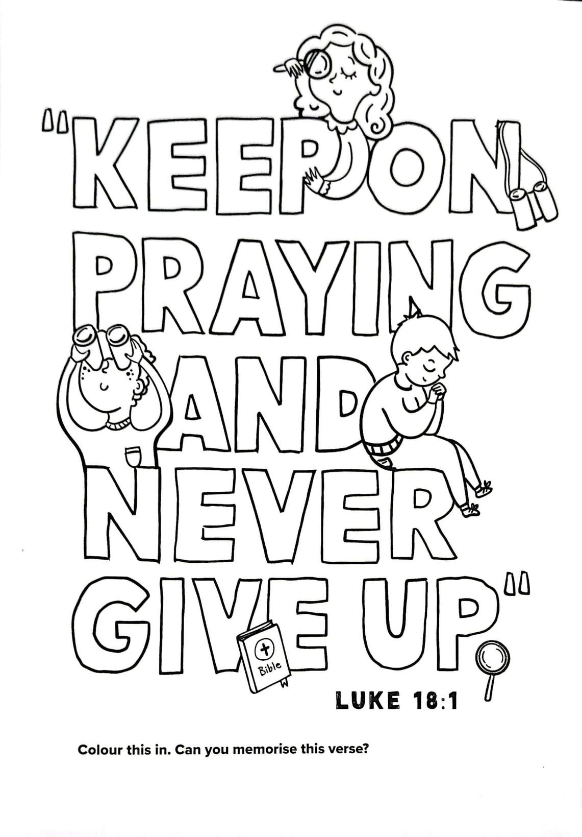



Memory
Verse:
Notes:
This verse is our big idea for today. Jesus said this because He knew life is hard sometimes—but prayer is powerful. Let’s say it together slowly. Now faster! Now in a whisper! Now shout it. This is something we can remember when things get tough—keep on praying, don’t give up.

Slide 3

Memory
Verse:

Slide 4

Memory
Verse:

Slide 5

Memory
Verse:

Slide 6

Memory
Verse:

Slide 7
Memory
Verse:

Slide 8
Memory
Verse:

Slide 9


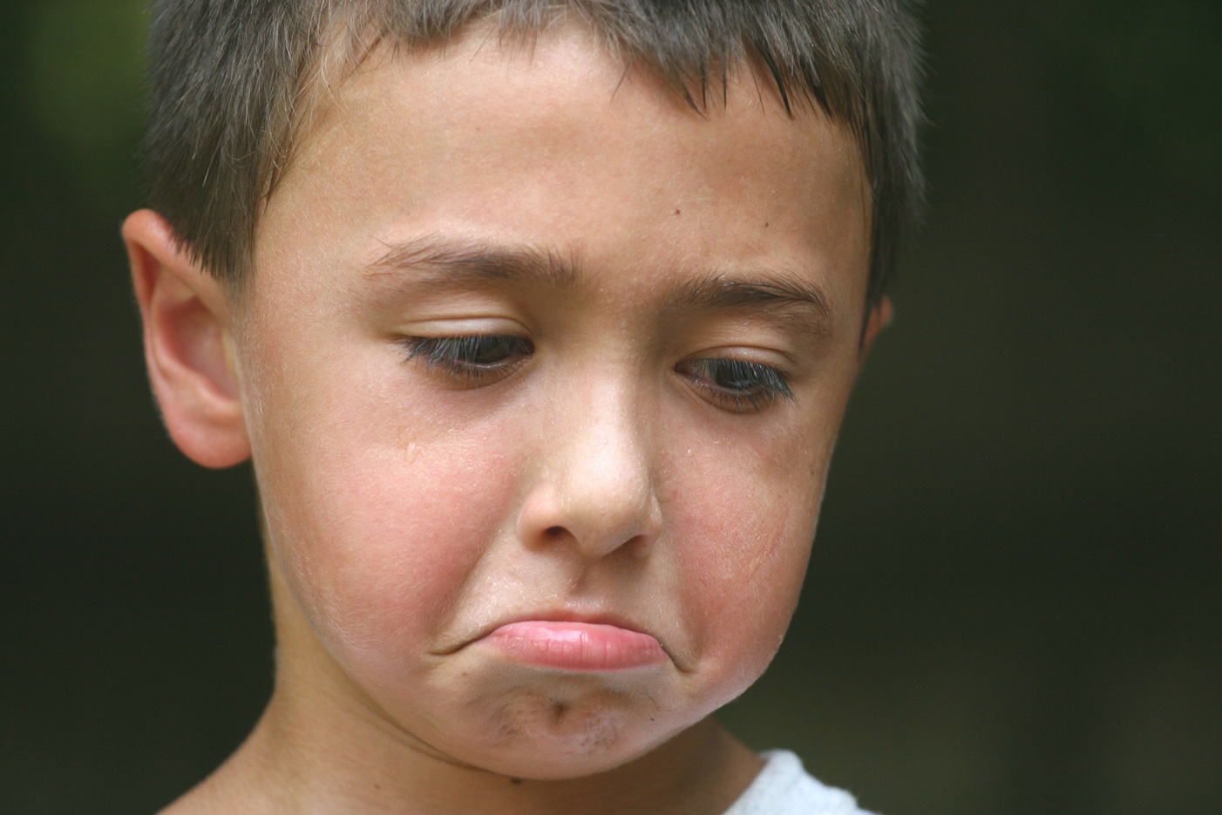



What is Persecution?
❌ Being treated badly for following Jesus.
Notes:
Persecution means being bullied, left out, or even hurt because you love Jesus. Around the world, millions of Christians—kids just like you—are persecuted. That’s not fair, is it? But we can make a difference by praying and remembering them.

Slide 10
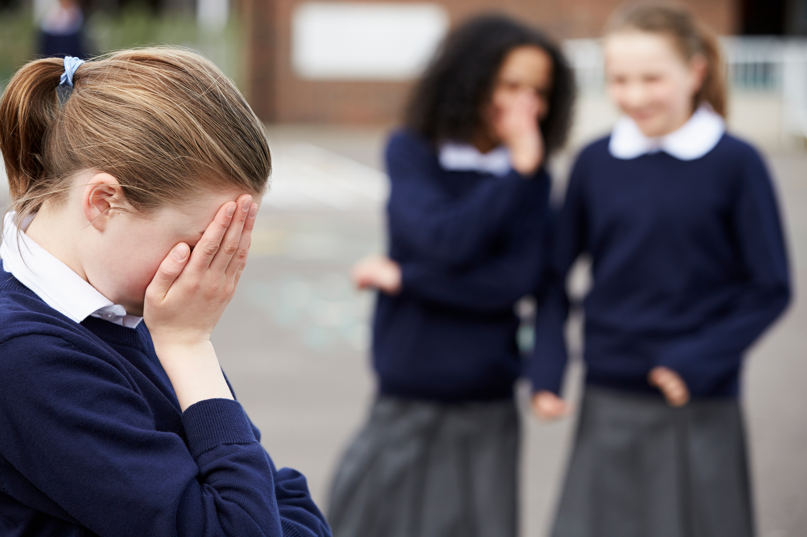
5 Ways Kids Face Persecution
1. Violence
2. Bullying
3. School problems
4. Secret believers
5. Losing homes
Notes:
Let’s talk about what persecution looks like for kids.
- Some are hurt or attacked—violence.
- Some are bullied or called names.
- Some aren’t allowed to go to school or teachers ignore them.
- Some must keep their faith a secret.
- Some lose their homes and must run away. These are real struggles kids face every day.

Slide 11

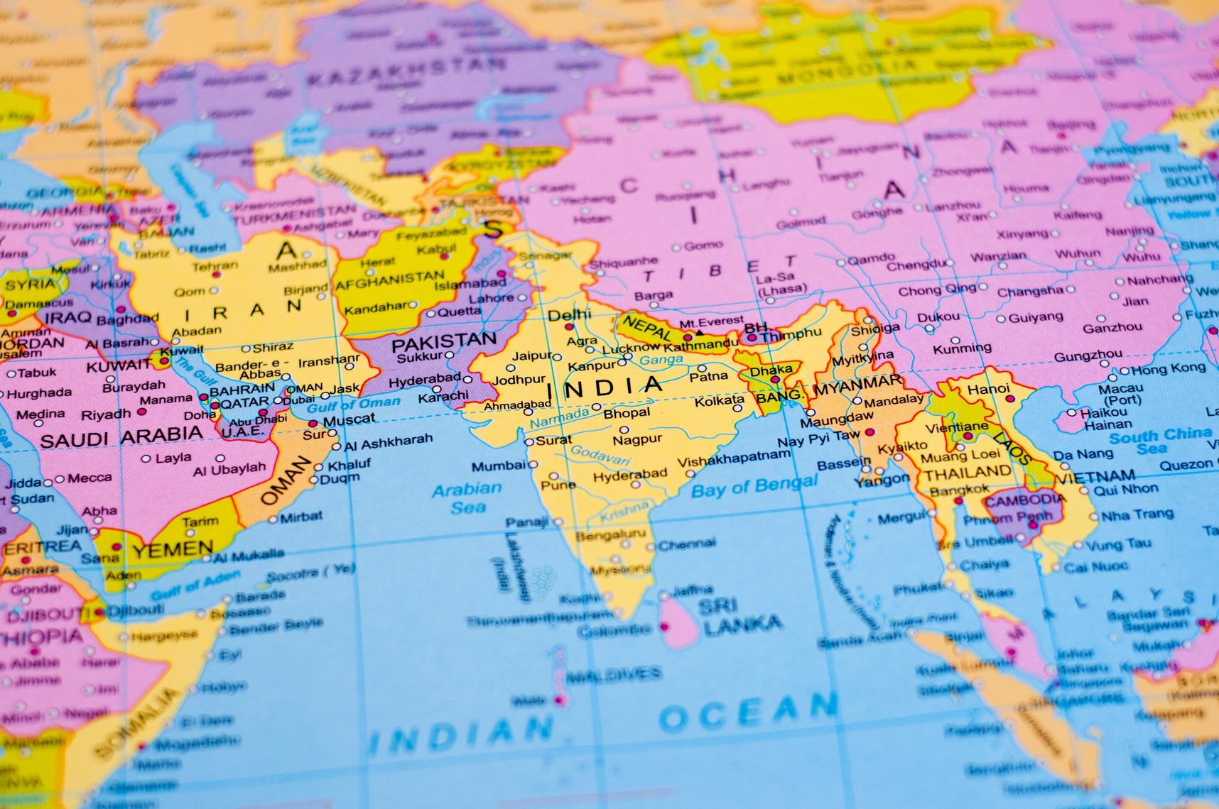
Stories of Real Children
📍 Iran
📍Egypt
📍Burkina Faso
📍 India
📍Iraq
Notes:
Today we’re going to hear real stories of children around the world who follow Jesus. These aren’t made up — they are happening right now. Each child faces a different kind of persecution, but we’ll also see how God helps them. After each story, we’ll pray together.”
You can also read these stories in your passport later.

Slide 12

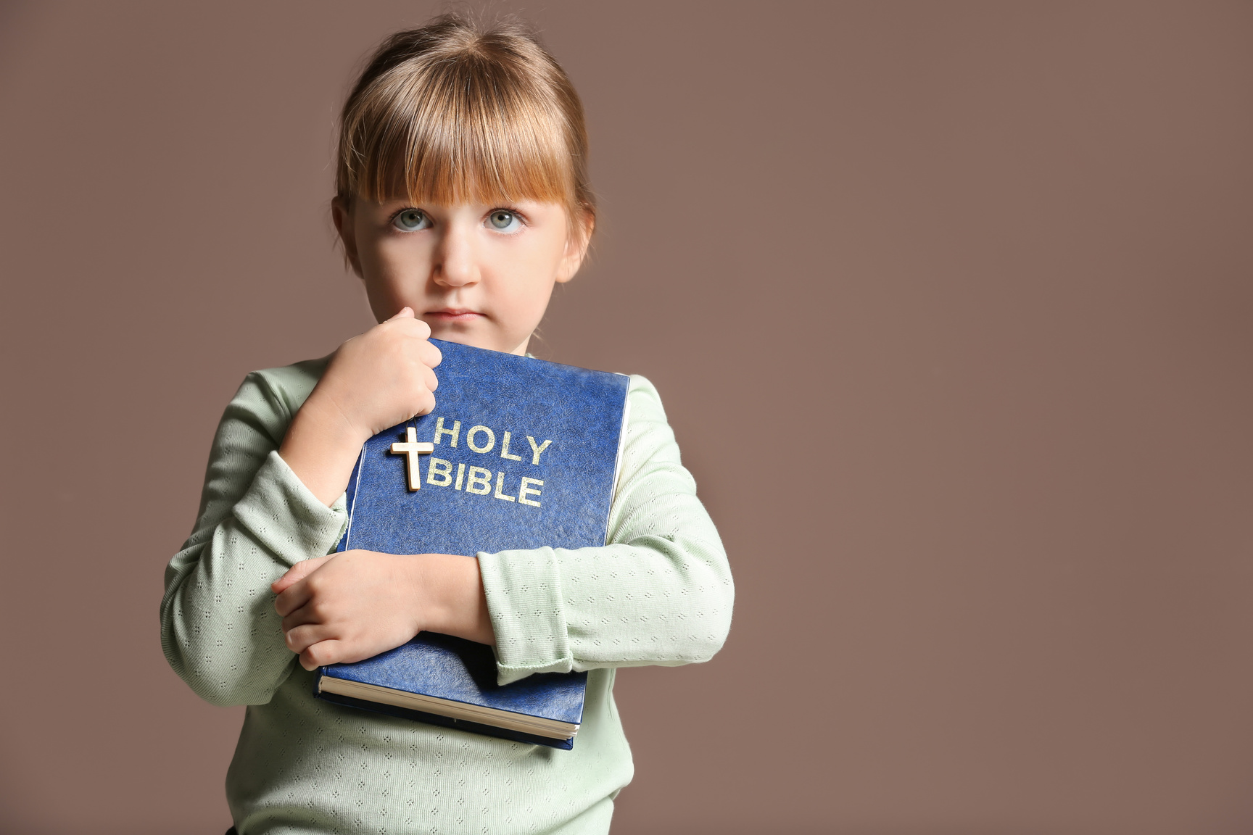

Sepideh (Iran)
Secret Believers
👧 Sepideh and her mum follow Jesus in secret.
⚠️ In Iran it’s illegal to leave Islam.
🙏 Pray for her safety and her father’s heart.
Notes:
Sepideh and her mother became Christians, but they couldn’t even tell her dad. When he found out, he threatened to report them to the police. Imagine not being able to tell your own family what you believe! Let’s pray that God keeps Sepideh safe, that her dad will come to know Jesus too, and that secret believers all over the world will find safe friends and churches.

Slide 13
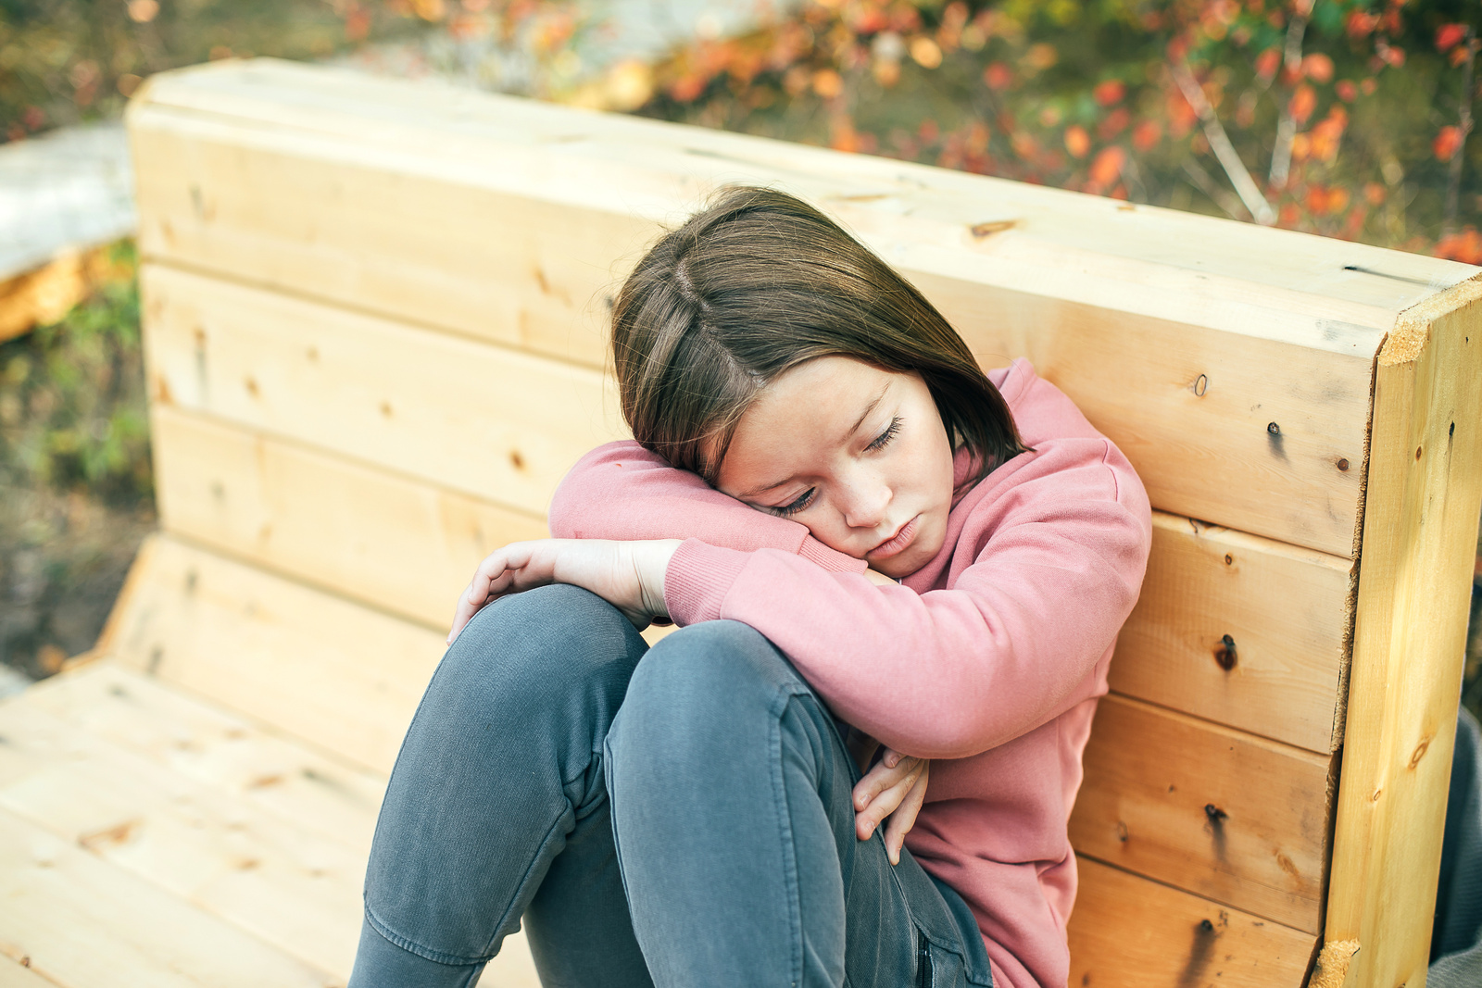
Julie (Egypt)
Bullying
👧 Julie is bullied at school for following Jesus.
💪 With help, she found courage: Romans 8:31 - ‘If God is for us, who can be against us?’
🙏 Pray for courage and for classmates to accept her.
Notes:
Julie feels different at school because she follows Jesus. The other kids leave her out and call her names. But she remembers the Bible verse: ‘If God is for us, who can be against us?’ God gave her strength to stand tall. Let’s pray Julie will keep her courage, and that her classmates will learn to accept and respect her.

Slide 14
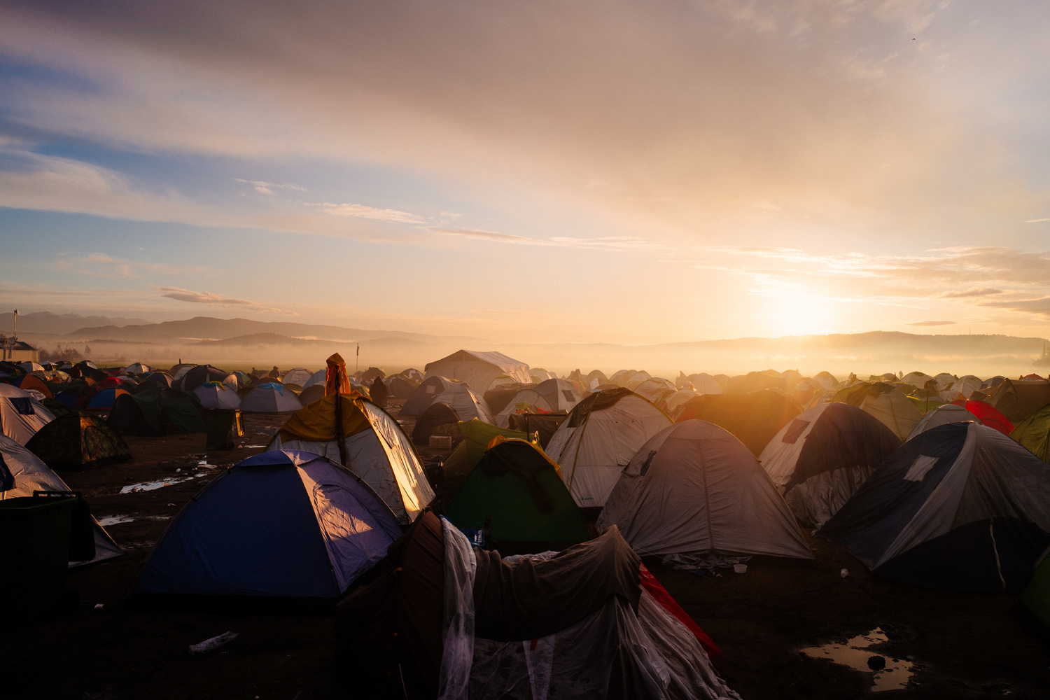
Wenkun (Burkina Faso)
Losing Homes
👦 Wenkun’s village was burned when he was 4.
🚶 His family walked 3 days to find shelter.
💬 His dad says: “We are displaced, but Jesus is not.”
🙏 Pray for safety and provision.
Notes:
“When Wenkun was just 4, extremists burned down his whole village. His family had to leave everything behind and walk for 3 days before they found safety. His dad said something powerful: ‘We are displaced, but Jesus is not.’ That means even when we lose our home, Jesus is still with us. Let’s pray for children like Wenkun to have food, water, and safe homes.”

Slide 15
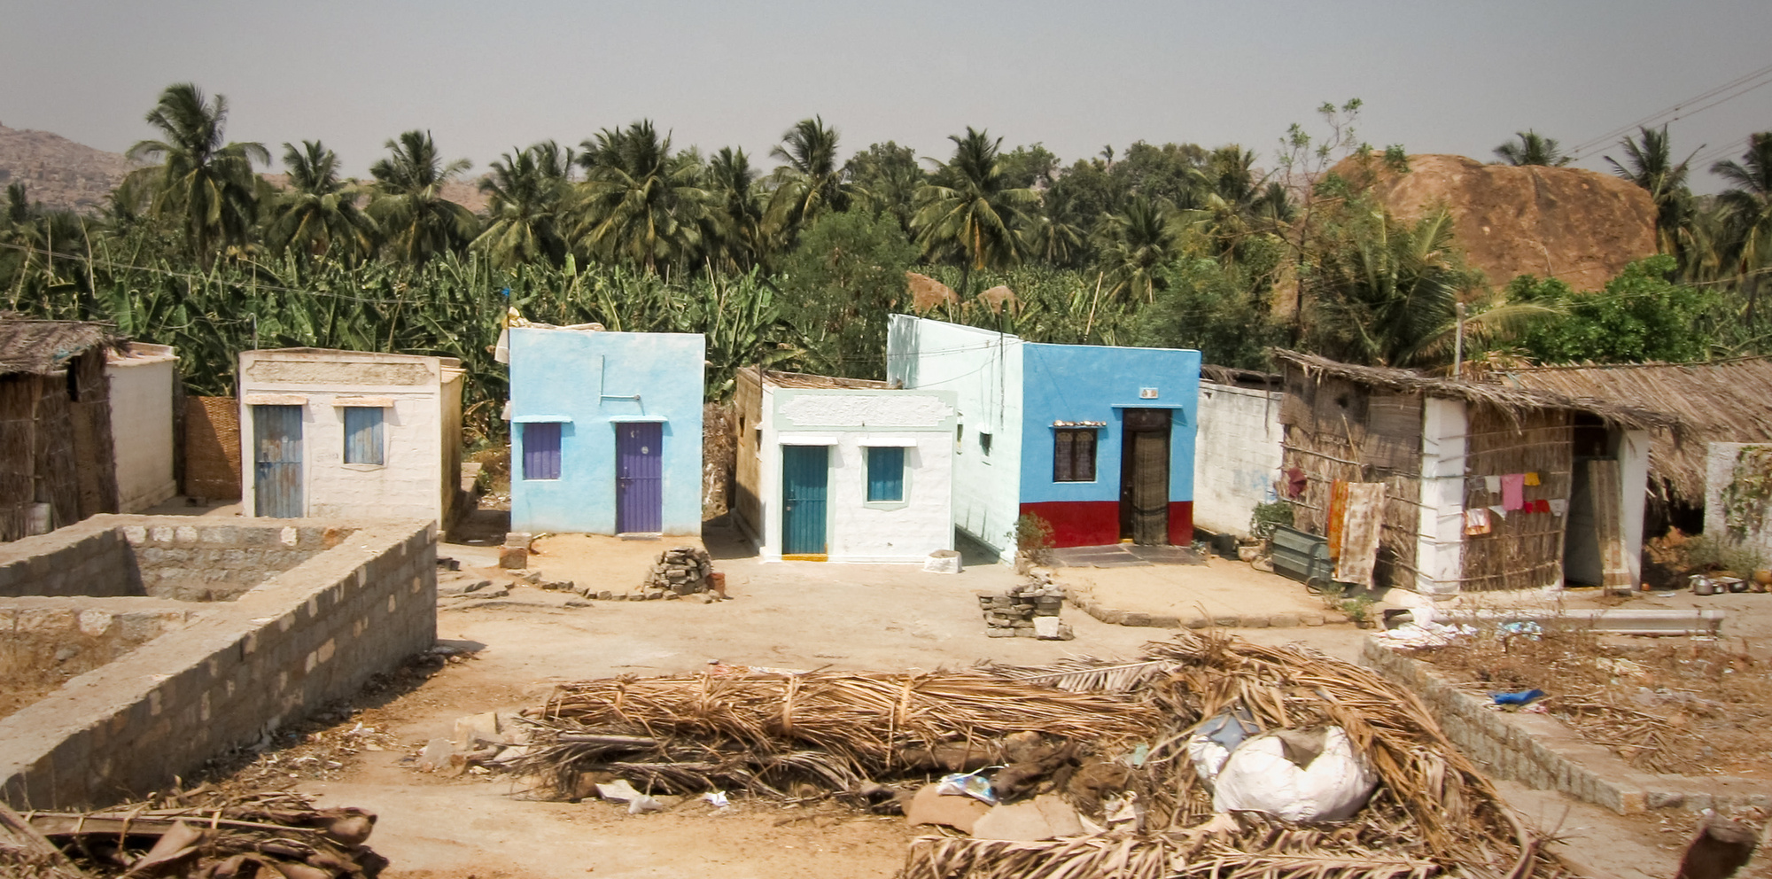
Preeti (India)
Violence
👧 Preeti’s grandfather was beaten for leading prayers.
💔 She felt scared and angry.
🙏 She asks us: “Pray for my family to grow in Christ.”
Notes:
Preeti’s grandfather held prayer meetings in their house. Local extremists attacked him with iron bars and hurt him badly. Preeti was frightened and angry — but instead of revenge, she asked for prayer. She said: ‘Pray for my family to grow in Christ and be safe.’ Isn’t that amazing? Let’s pray for Preeti’s family and others who face violence.”

Slide 16
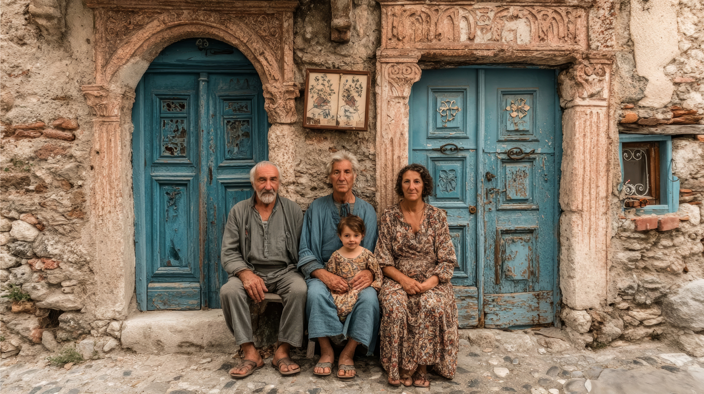
Benham (Iraq)
School Problems
👦 Benham’s house was burned when he was a toddler.
🏠 Years later, his family rebuilt their home.
🙏 Pray for peace, safety, and education.
Notes:
“When Benham was little, extremists burned his house. His family had to run away. But a few years later, they were able to return and rebuild their home with help from Open Doors. Not every child is so fortunate. Let’s pray for children like Benham — that they can go to school safely, live without fear, and enjoy peace in their homes.”

Slide 17
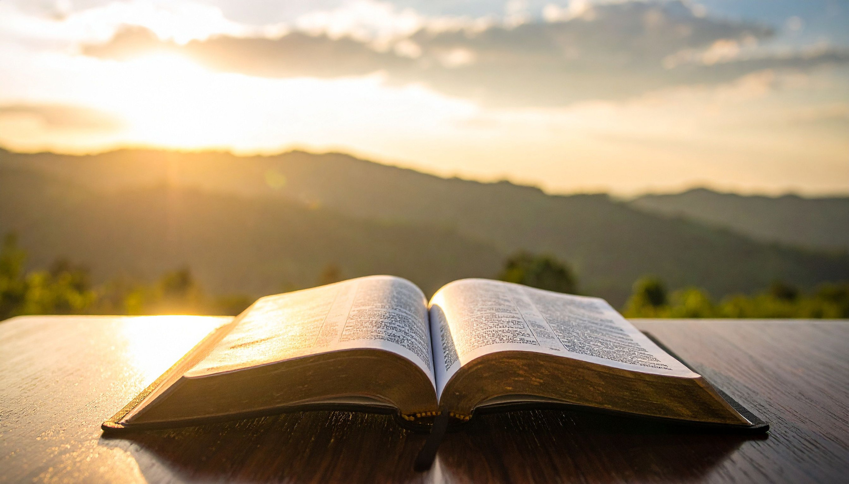
📖 What does the Bible say about persecution?
•“If they persecuted me, they will persecute you also.” (John 15:20)
•“Everyone who wants to live a godly life… will be persecuted.” (2 Tim 3:12)
•“Blessed are you when people persecute you…” (Matt 5:11–12)
Notes:
The Bible tells us persecution is part of following Jesus. Jesus was persecuted, and his followers were too. But God promises blessings and joy even in suffering, because He is close to us. These verses remind us we are not alone.”

Slide 18
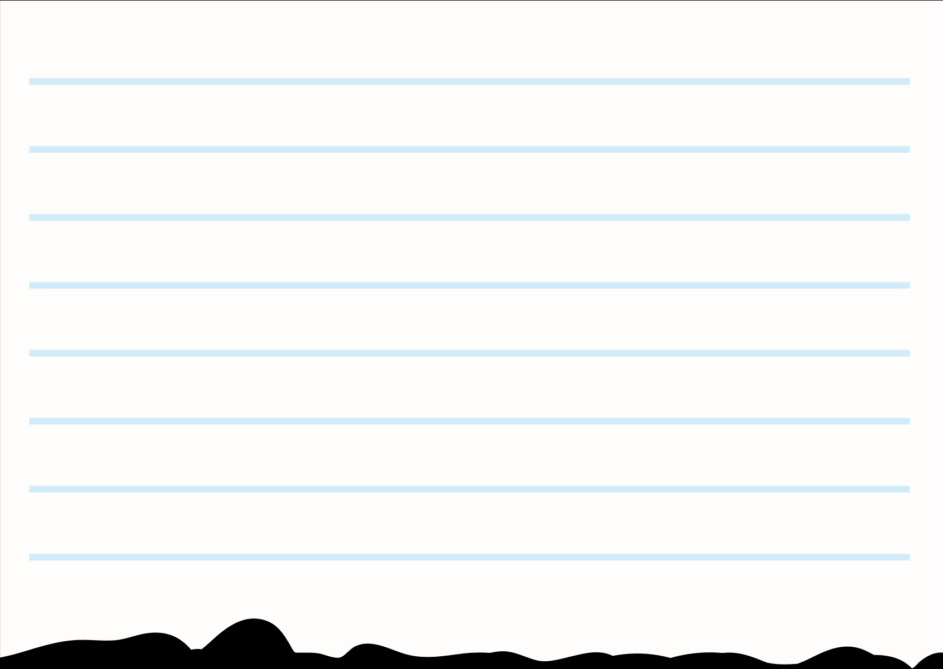
Who are Open Doors?
Helping persecuted Christians:
🏠 💊 🎒 📚 📖
- Food & homes
- Medicine
- Education
- Bibles
Notes:
Open Doors helps Christians who are persecuted. They provide food, safe homes, medicine, schools, and bring Bibles. They remind persecuted Christians: ‘You are not alone.’ And today, as World Watchers, we are part of that too!

Slide 19

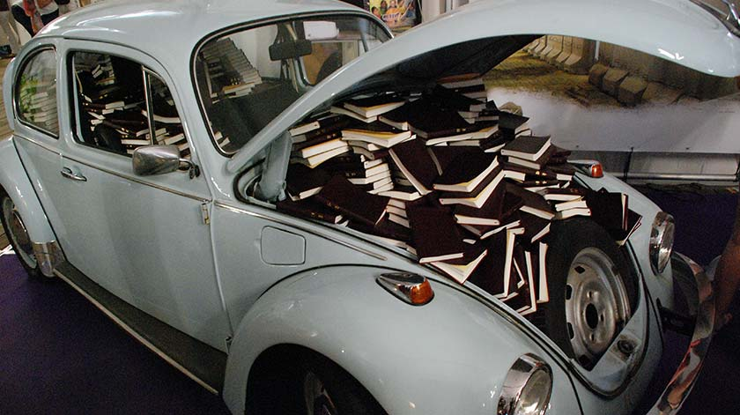

The Original World Watcher
✝️ Brother Andrew
🚗 1955: smuggled Bibles in a blue Beetle car.
🌍 Founded Open Doors, helping Christians in 60+ countries.
📚 Story in God’s Smuggler / Secret Smuggler.
Notes:
“Brother Andrew was one of the first ‘World Watchers.’ He risked his life to smuggle Bibles to Christians who couldn’t get them. Later he started Open Doors, the group that still helps today. His story shows how one person’s prayers and bravery can change the world.”

Slide 20
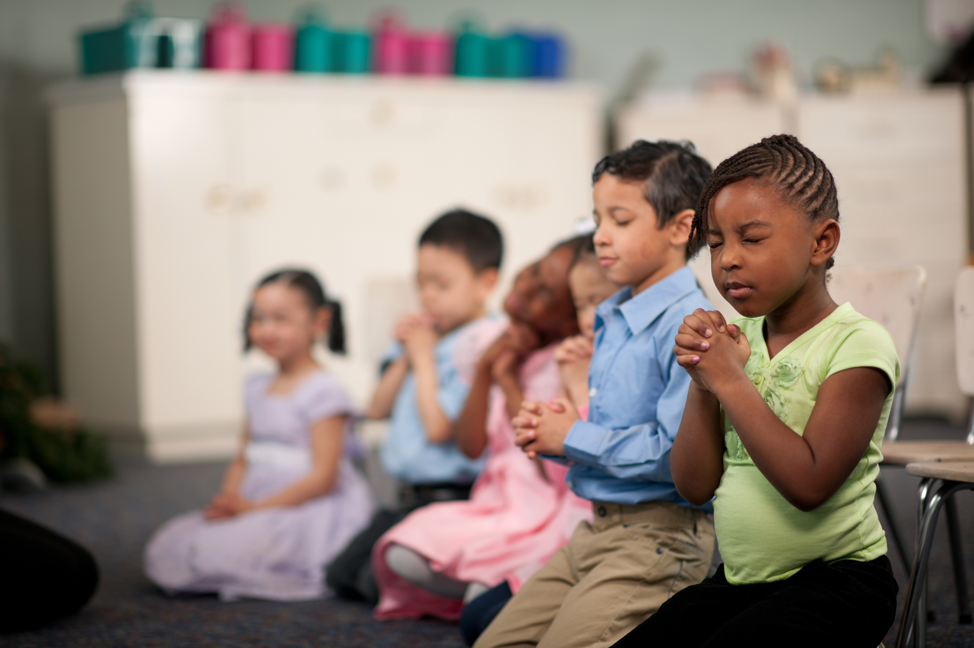
Why Pray?
Because God Listens.
🙏 God listens.
💡 Prayer brings hope.
🌍 Our prayers reach the world.
Notes:
Prayer is powerful because God listens! Even when Christians are far away, our prayers reach them because God is everywhere. Prayer gives hope, brings courage, and reminds people that they are loved by God. Remember Luke 18:1? Keep praying, never give up.

Slide 21
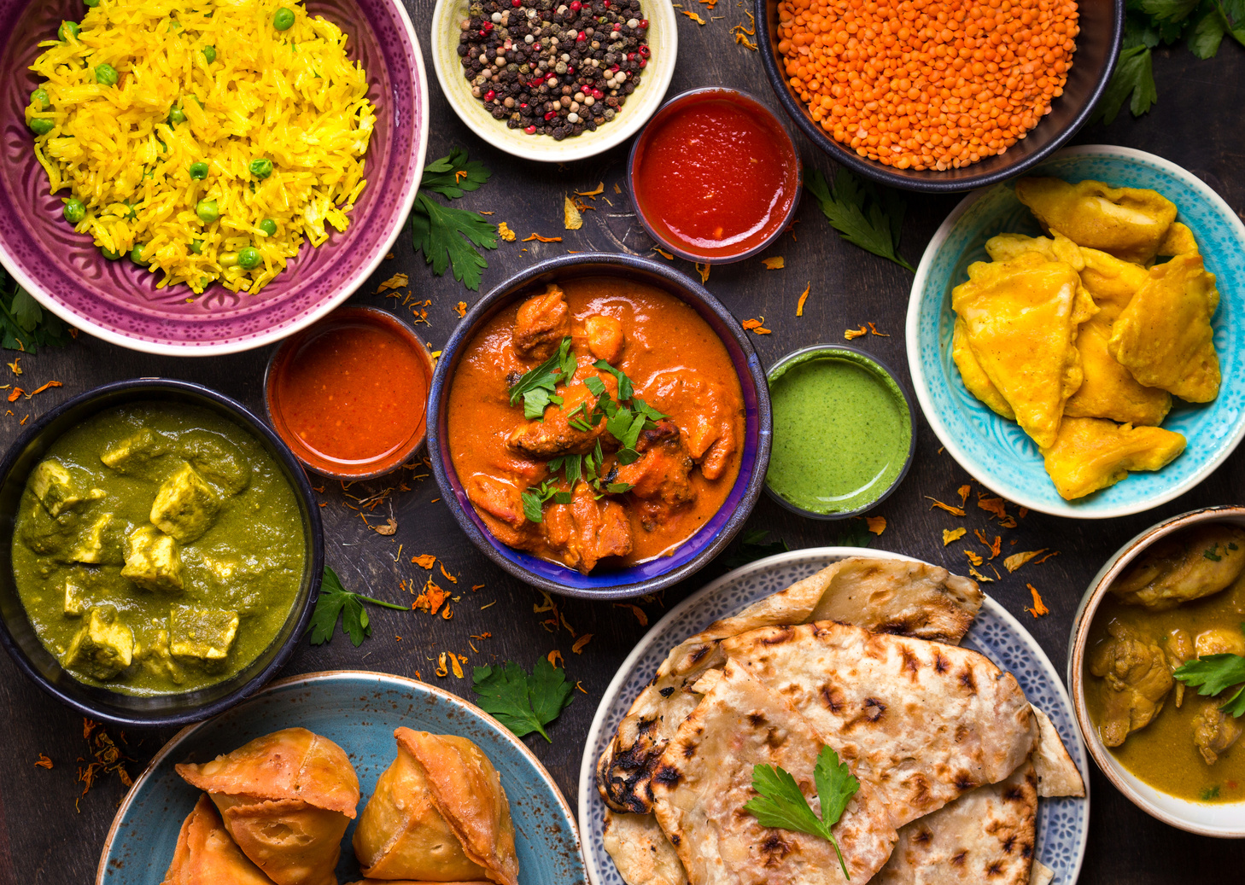
ideas for Prayer
🙏 Ways to Pray
•Watch what you eat: Pray when eating food from another country.
•Watch closely: Choose one country to focus on.
•Neighbourhood watch: Use things you see to inspire prayer.
Notes:
“Prayer can be part of everyday life! If you eat Chinese food, pray for Christians in China. If you see a lamppost, pray for Christians to shine for Jesus. If you see a school, pray for children to get education. These little reminders help us pray without giving up.”

Slide 22
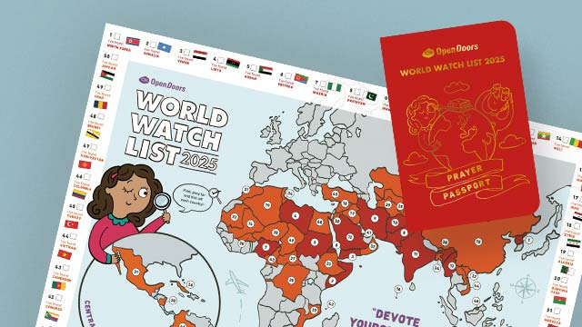
✈️ Pick a country.
🎨 Colour the flag.
✍️ Write a prayer.
✅ Tick your map.
Notes:
Now it’s your turn to be real World Watchers!
1. Pick a country on your prayer passport map.
2. Colour its flag.
3. Write a short prayer for kids there.
4. Tick your map—you’ve just ‘visited’ that country in prayer! This is your special journey—you can keep filling it during the week at home too.

