Slide 1
How to be an MCC children’s leader!

Slide 2
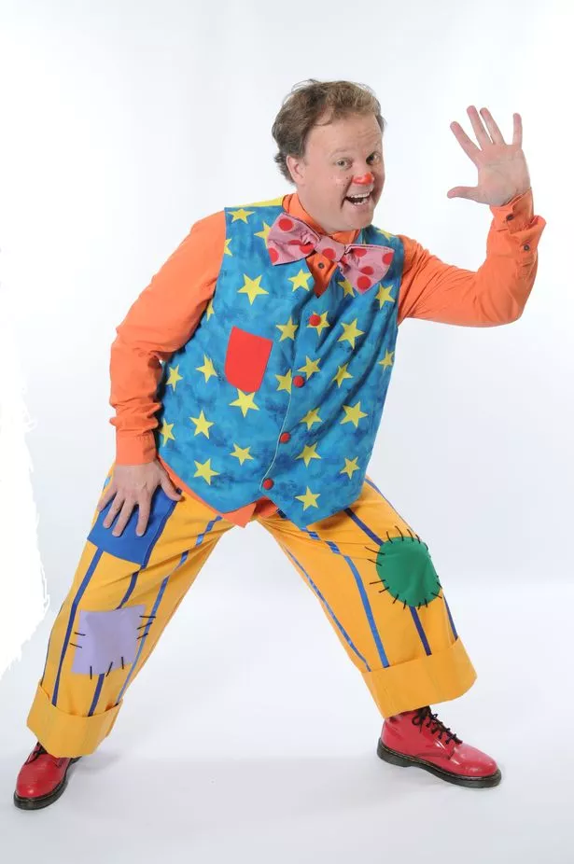
You’ll be glad to
know
It’s not this!
But you need a DBS
and be a member
of MCC

Slide 3
Preparing to Lead a Children’s Meeting.
You are not going to get it all perfect I don’t after 40 years!
It will take lots of practice before you are able and confident to do it all.
This session hopefully will help you know what you are aiming for.
Success is not about programmes, techniques or experience - it's about whether you are willing to let the Holy Spirit use you - in one way you've succeeded by just being willing to have go!
Hopefully these principles will be the beginning of an exciting journey.

Slide 4
General Spiritual Principles
1. Leading is not about personality or performance Don't think you will wow everybody if you put on a great 'show' with loads of gimmicks, entertainment and 'fun stuff'. That's not the leader’s job. People can't see Jesus if you are in the way! Ask God to fill you with the Holy Spirit whilst you prepare and as you lead, so that Jesus is the main attraction, not you!
2. The leader’s job is to facilitate the message and the team You are a 'link' person - the 'glue' that makes sure the individual building blocks flow together and all convey the same message.
3. Know the application of the day. Make sure you know exactly what the application is for the meeting you are leading. Emphasis on only having one clear point in a lesson. E.g. God loves you, God forgives, God listens .Make sure you understand what the application means in its entirety - you can't teach others what you don't know or understand yourself! If you're not sure - ask!
4. Know how the application relates to the songs, memory verse and story. The individual parts of a programme shouldn’t have been chosen at random but fit together where possible.

Slide 5
General Practical Principles
1. Leaders lead and followers follow. (a) People need to be given a lead in order to know what to do next. If you let everybody do what they think is right at the time in their own mind you will end up with chaos. So know what the schedule is - the timings - how long things should take, what time things should be starting, etc. etc. You won't always get things to happen on time because you can't be 100% in control of how long it takes to do the items, but try to keep one eye on the clock so we stand as good a chance as we can to give each item its fair time and ultimately finish on time. (b) Be clear when you do things like lead songs - know the actions for example and do them boldly not apologetically. If the leader is half-hearted or apparently embarrassed, so will everybody else be! (c) Encourage the team (d) Don't let power go to your head; don't start barking orders - that's not pretty! Remember - it's not about you!
2. Pay attention! Remember how your job is to be the 'glue'? In order to succeed in this you have to be constantly watching and carefully listening to everything that goes on, ask yourself "are we getting today's point across?" Do they understand?". If anything needs clarifying, correcting, explaining or reinforcing – do it! That's why it is so important that you know and fully understand the application.
3. Have fun and enjoy yourself. If you are relaxed and enjoy yourself, so will the kids. Humour is a great communicator. But don't let it become a 'show' - everything you do should have a purpose. Everything should reinforce the application. Don't fall into the trap of thinking leading is all about being goofy and entertaining the kids - if we wanted that we'd hire a clown!

Slide 6
Hints and Tips - Infants
1. Sensory Overkill Younger kids aren't so keen on extreme sensory experiences! For example, louder is not necessarily better for littlies, darkness is just plain scary for some littlies! If you're leading the infants meeting be gentler, smile, be protective towards these vulnerable and precious little ones.
2. Age Appropriateness Be careful about your illustrations and analogies when you're teaching or reinforcing the application. Some of these children have only just started school so it's not a greatly familiar environment yet. Their life experience is still very limited and they won't be able to relate to lots & lots of stuff. Keep your illustrations simple and basic.
3. Developmental Age Don't expect them to be able to cope with big or complicated concepts - they're not thick – it’s just that their brains haven't developed enough yet to be able to process complicated ideas and concepts! Keep it simple and keep asking yourself, "Would a 4-year old understand this?"

Slide 7
4. Vocabulary Think carefully about the vocabulary you use - use normal language not 'language of the kingdom' (jargon and Christian phraseology that the kids won't understand).
5. Team Work Prior to the Meeting. Before the meeting, communicate with others so they know what they are doing and when. Email scripts etc to the team.
6. Singing - it’s like Marmite! Try to choose songs which have some connection with the theme (difficult I know). Aim for one song at the start, one at the end and maybe one in the middle. Remember, littlies need songs which are simple to sing and don't take too much reading ability for them to be able to join in.

Slide 8
Hints and Tips - Juniors
1. Reality vs Image Don't try to be cool, trendy or 'in' - they'll see right through you! Be yourself - they'll see that too and respect you for it.
2. Vocabulary Talk their language - think carefully about your vocabulary - don't use Christian buzzwords, jargon or 'language of the kingdom'. For example, say "God" or "Jesus", not "the Lord", etc. Don't talk down to them or be condescending; consider treating them as young adults!
3. Relate To Their World Not The Other Way Round Use illustrations and analogies they are going to relate to – Primary School is a massive part of a child's life and lots of major, life-shaping stuff happens there - tap into their world and experience. Think about what kids are into, their mindset and 'level' and tap into that. Lots of values are taught in school (both classroom and playground) - a few bad ones need contradicting with explanations of why, but the large majority need reinforcing because they are good - tap into that world and mindset! Don't force a child to understand your world and life-context - you need to move to theirs!

Slide 9
4. Team Work Prior to the meeting communicate with the rest of the team so they know when they're going to do. Email scripts etc to the team.
5. Singing - it’s like Marmite! Try to choose songs which have some connection with the theme (difficult I know). Aim for two or three songs at the start, one rousing anthem(!) at the end and maybe have a spare ready for the middle in case you need it. Remember that older Juniors (year 5 & 6s, especially boys) don’t really like singing cheesy songs with cringy actions – they’re more into R&B and Hip-Hop!! Don’t fall into the trap of thinking that singing = worship. There’s a lot more to worship than songs – be creative and use your imagination if you want to include worship

Slide 10

So at MCC what’s actually involved?
Safeguarding Policy
Health and Safety
Preparation
Setting up the room
Registration
Allergies and additional needs
Sweets, Drinks and biscuits
Fire Evacuation
Discipline
Toileting
Elements – quiz, songs, memory verse, story, games, crafts

Slide 11



So what’s actually involved?
Safeguarding Policy

Slide 12
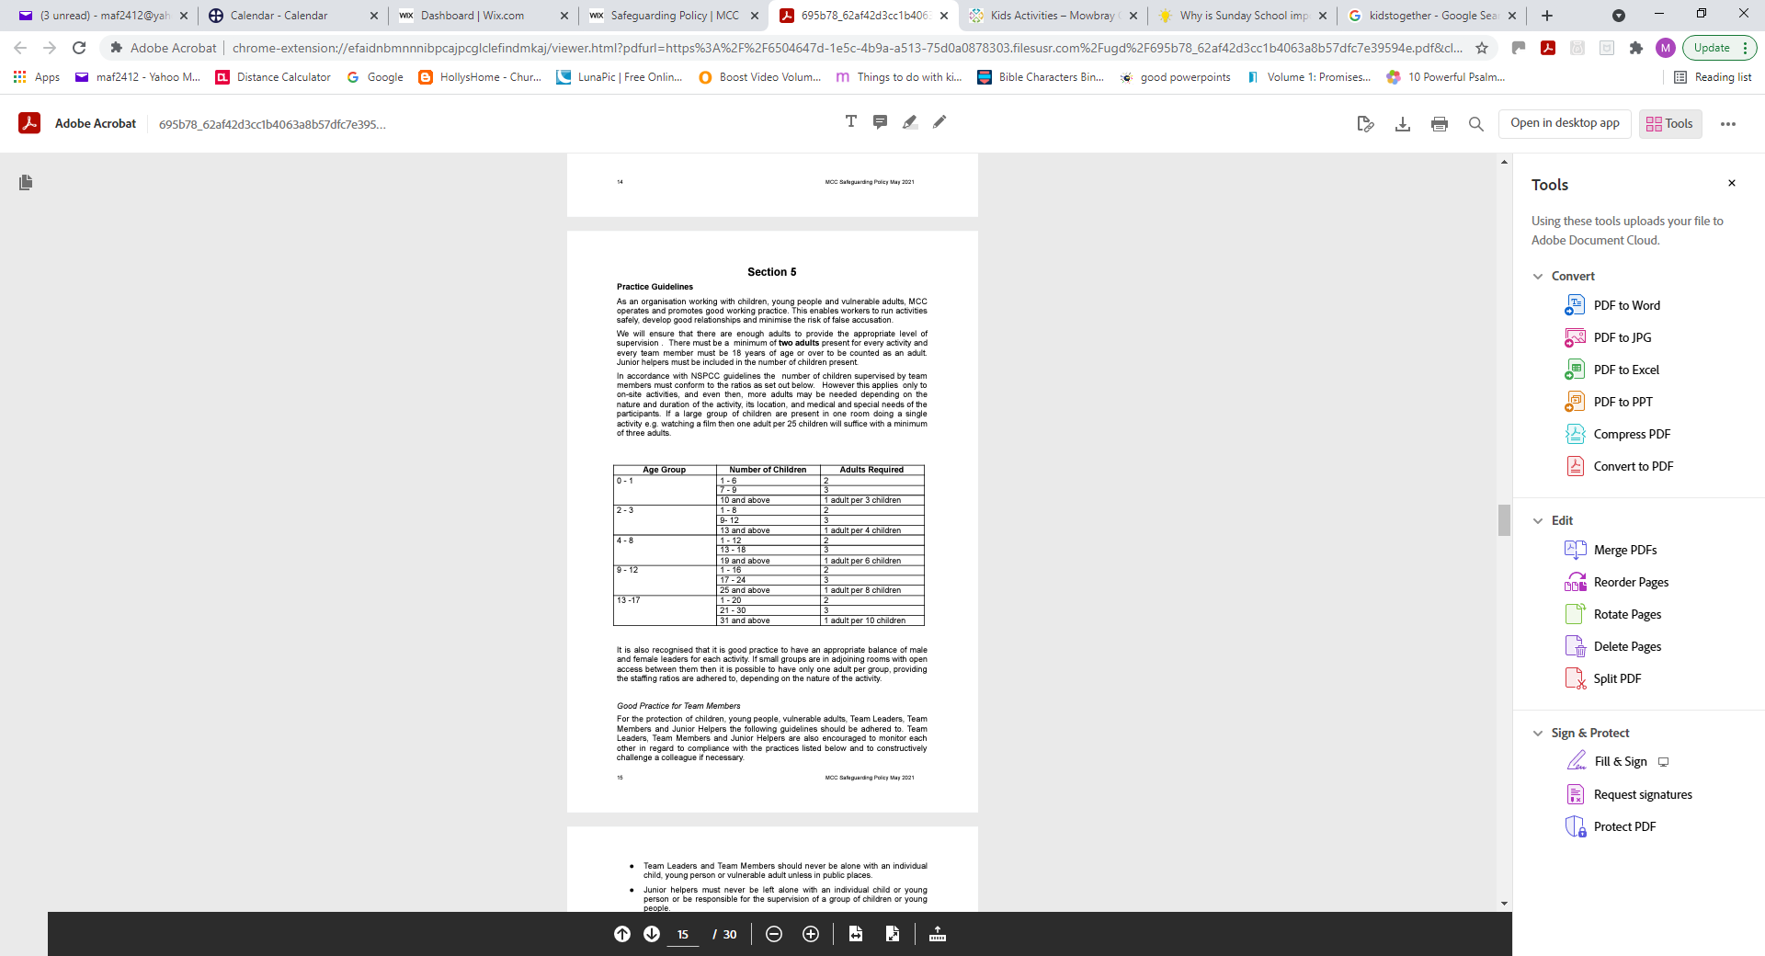
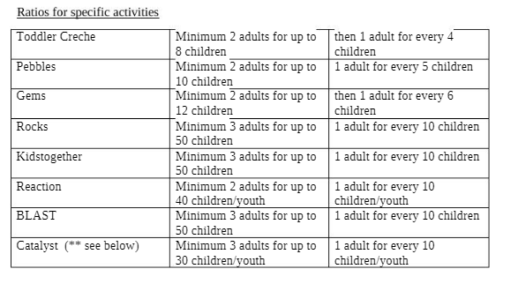
Number of children in each group
Creche 1-5 children
Pebbles 10-13 children
Gems 12-20 children
Rocks 14-23 children

Slide 13


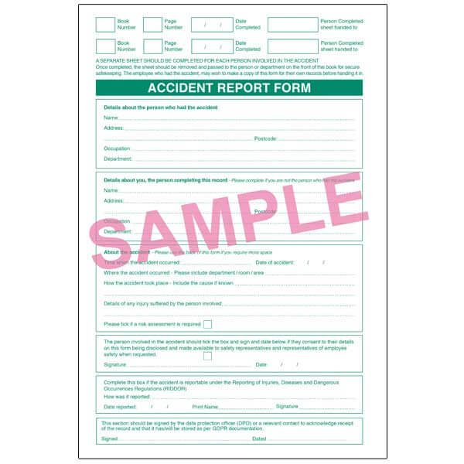
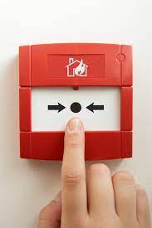
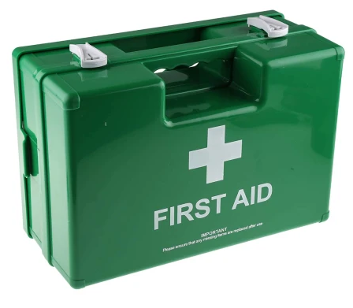

Heath and Safety issues
First Aid Kit and Procedures

Slide 14
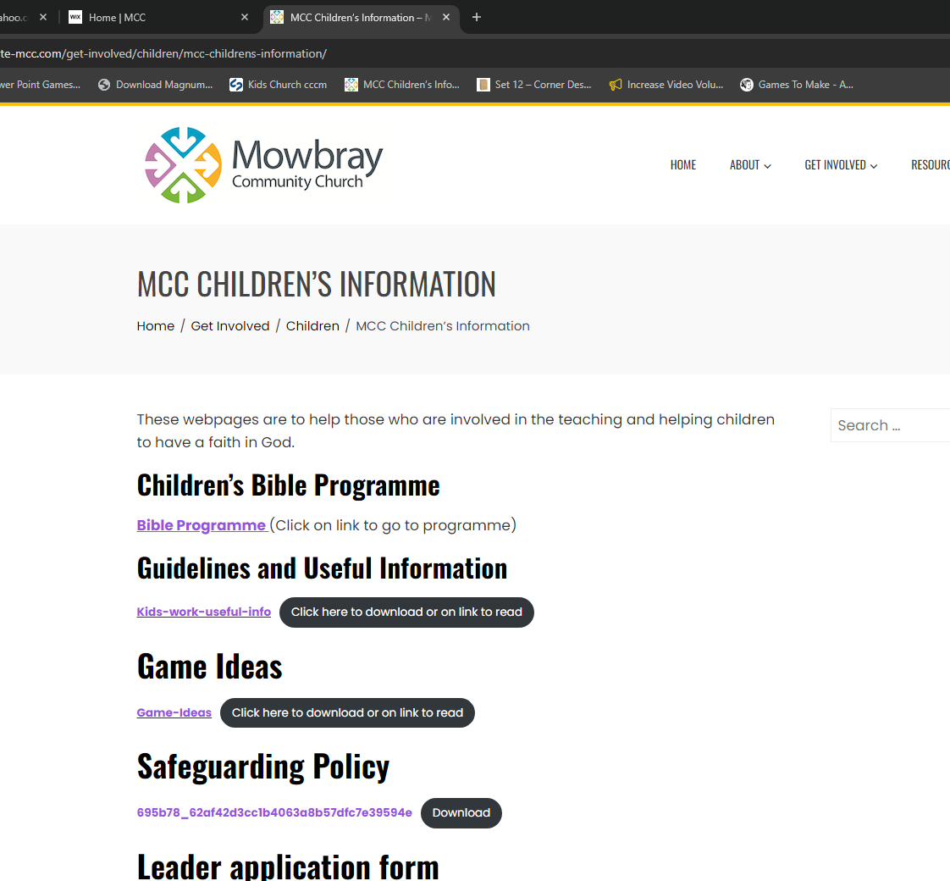

So what’s actually involved?
Preparation
Start with Prayer
Tools to help :-
Google / Scripture Union
https://www.harrogate-mcc.com/get-involved/children/mcc-childrens-information/
Top of the bible programme page are some useful sites.
Youtube
YoutubeHD Downloader
Windows Movie Maker
VLC – extract mp3 from video
www.RightNowMedia.org

Slide 15
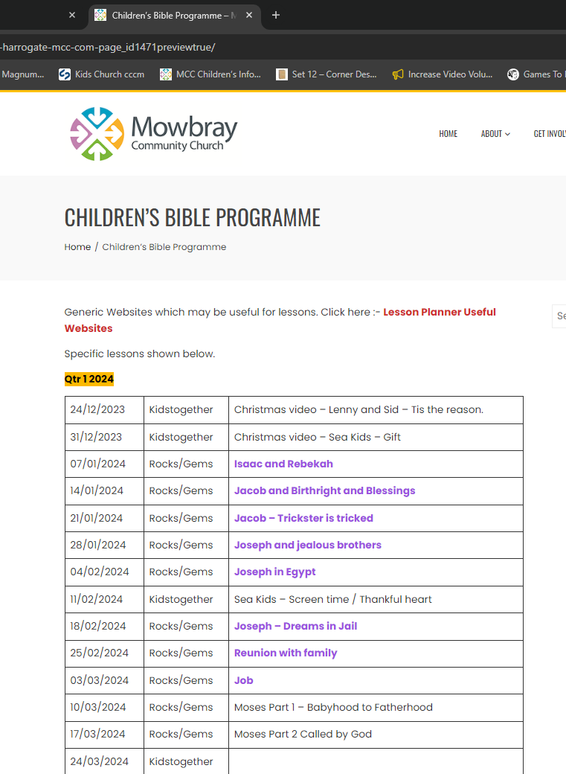
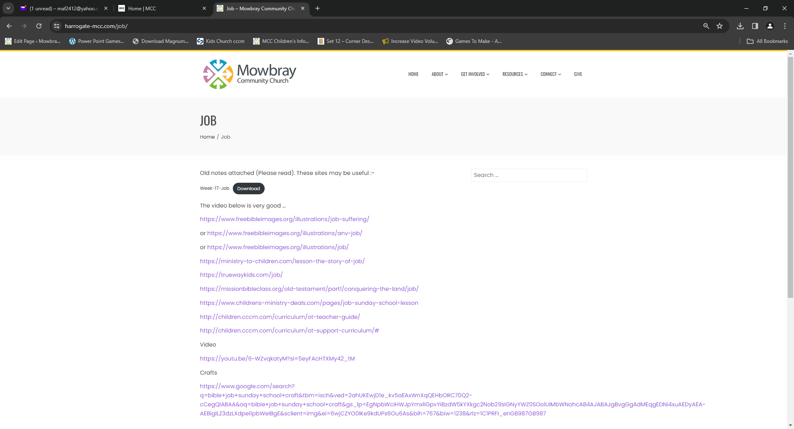
MCC Children’s Information
https://www.harrogate-mcc.com/mcc-childrens-information

Slide 16
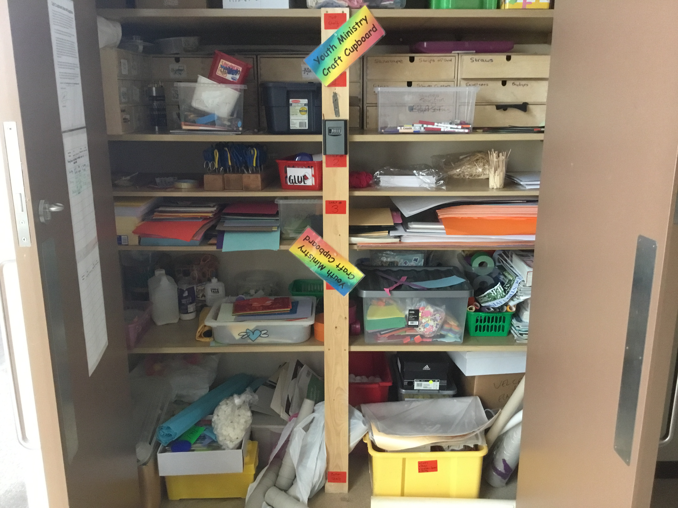
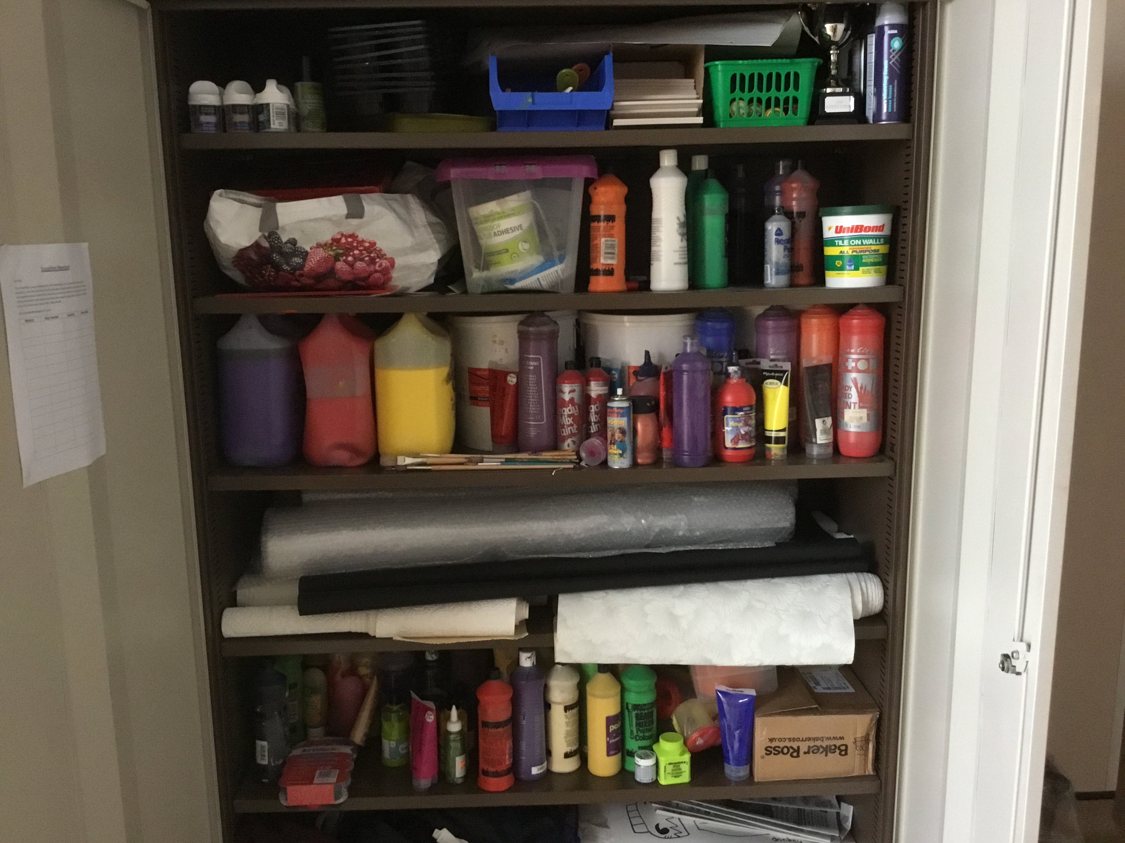
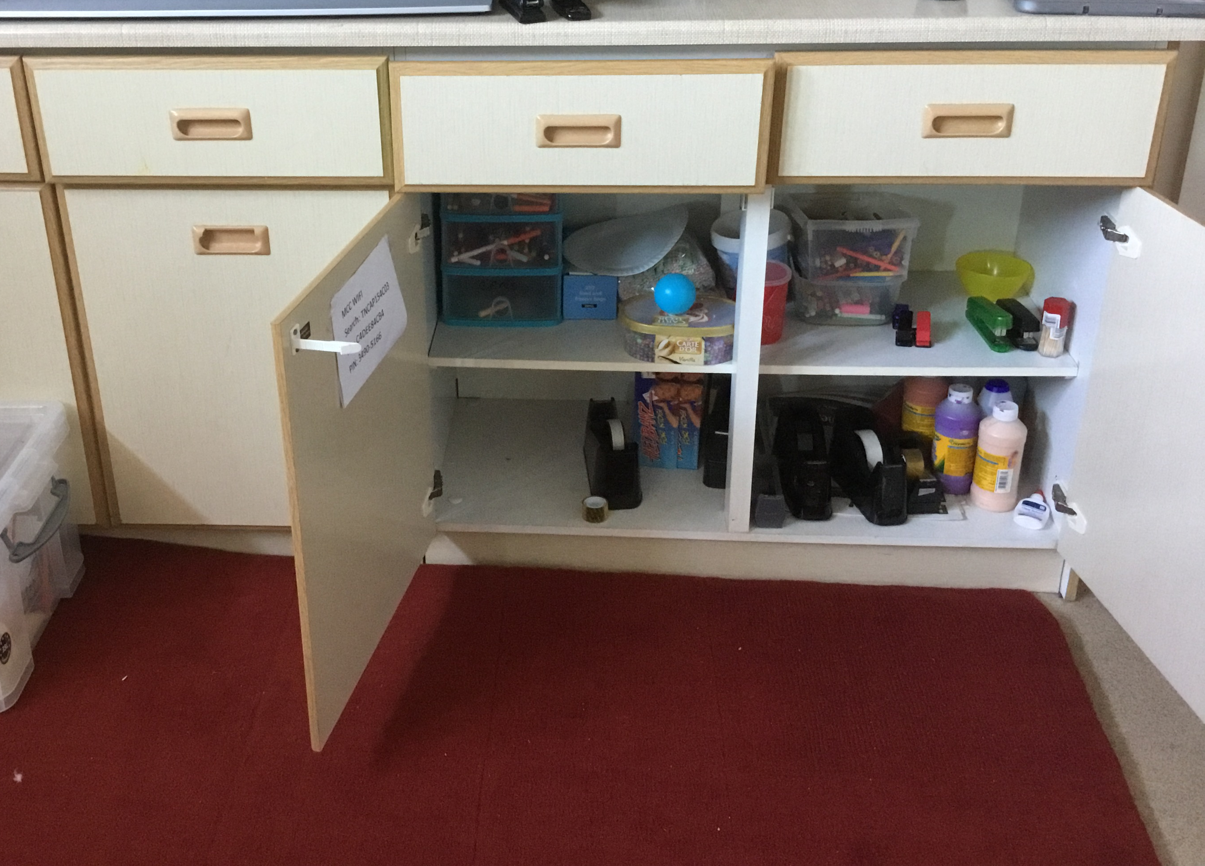
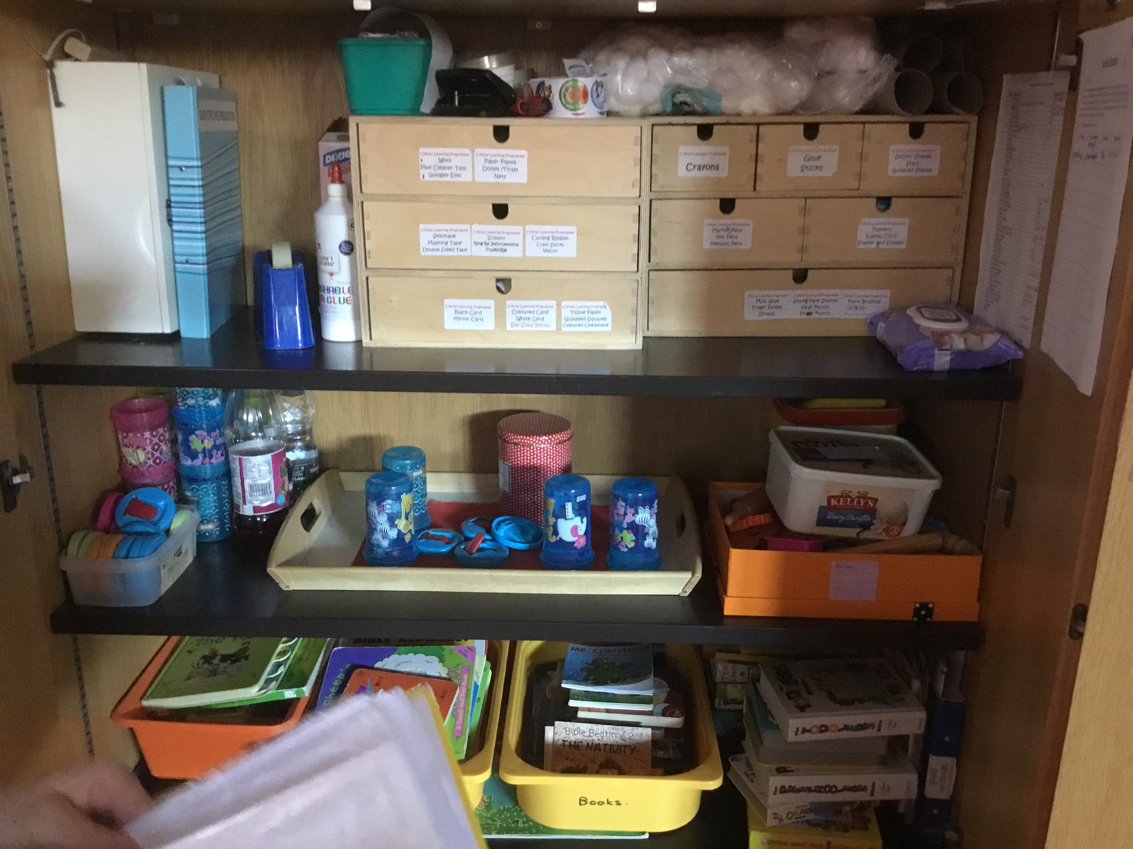
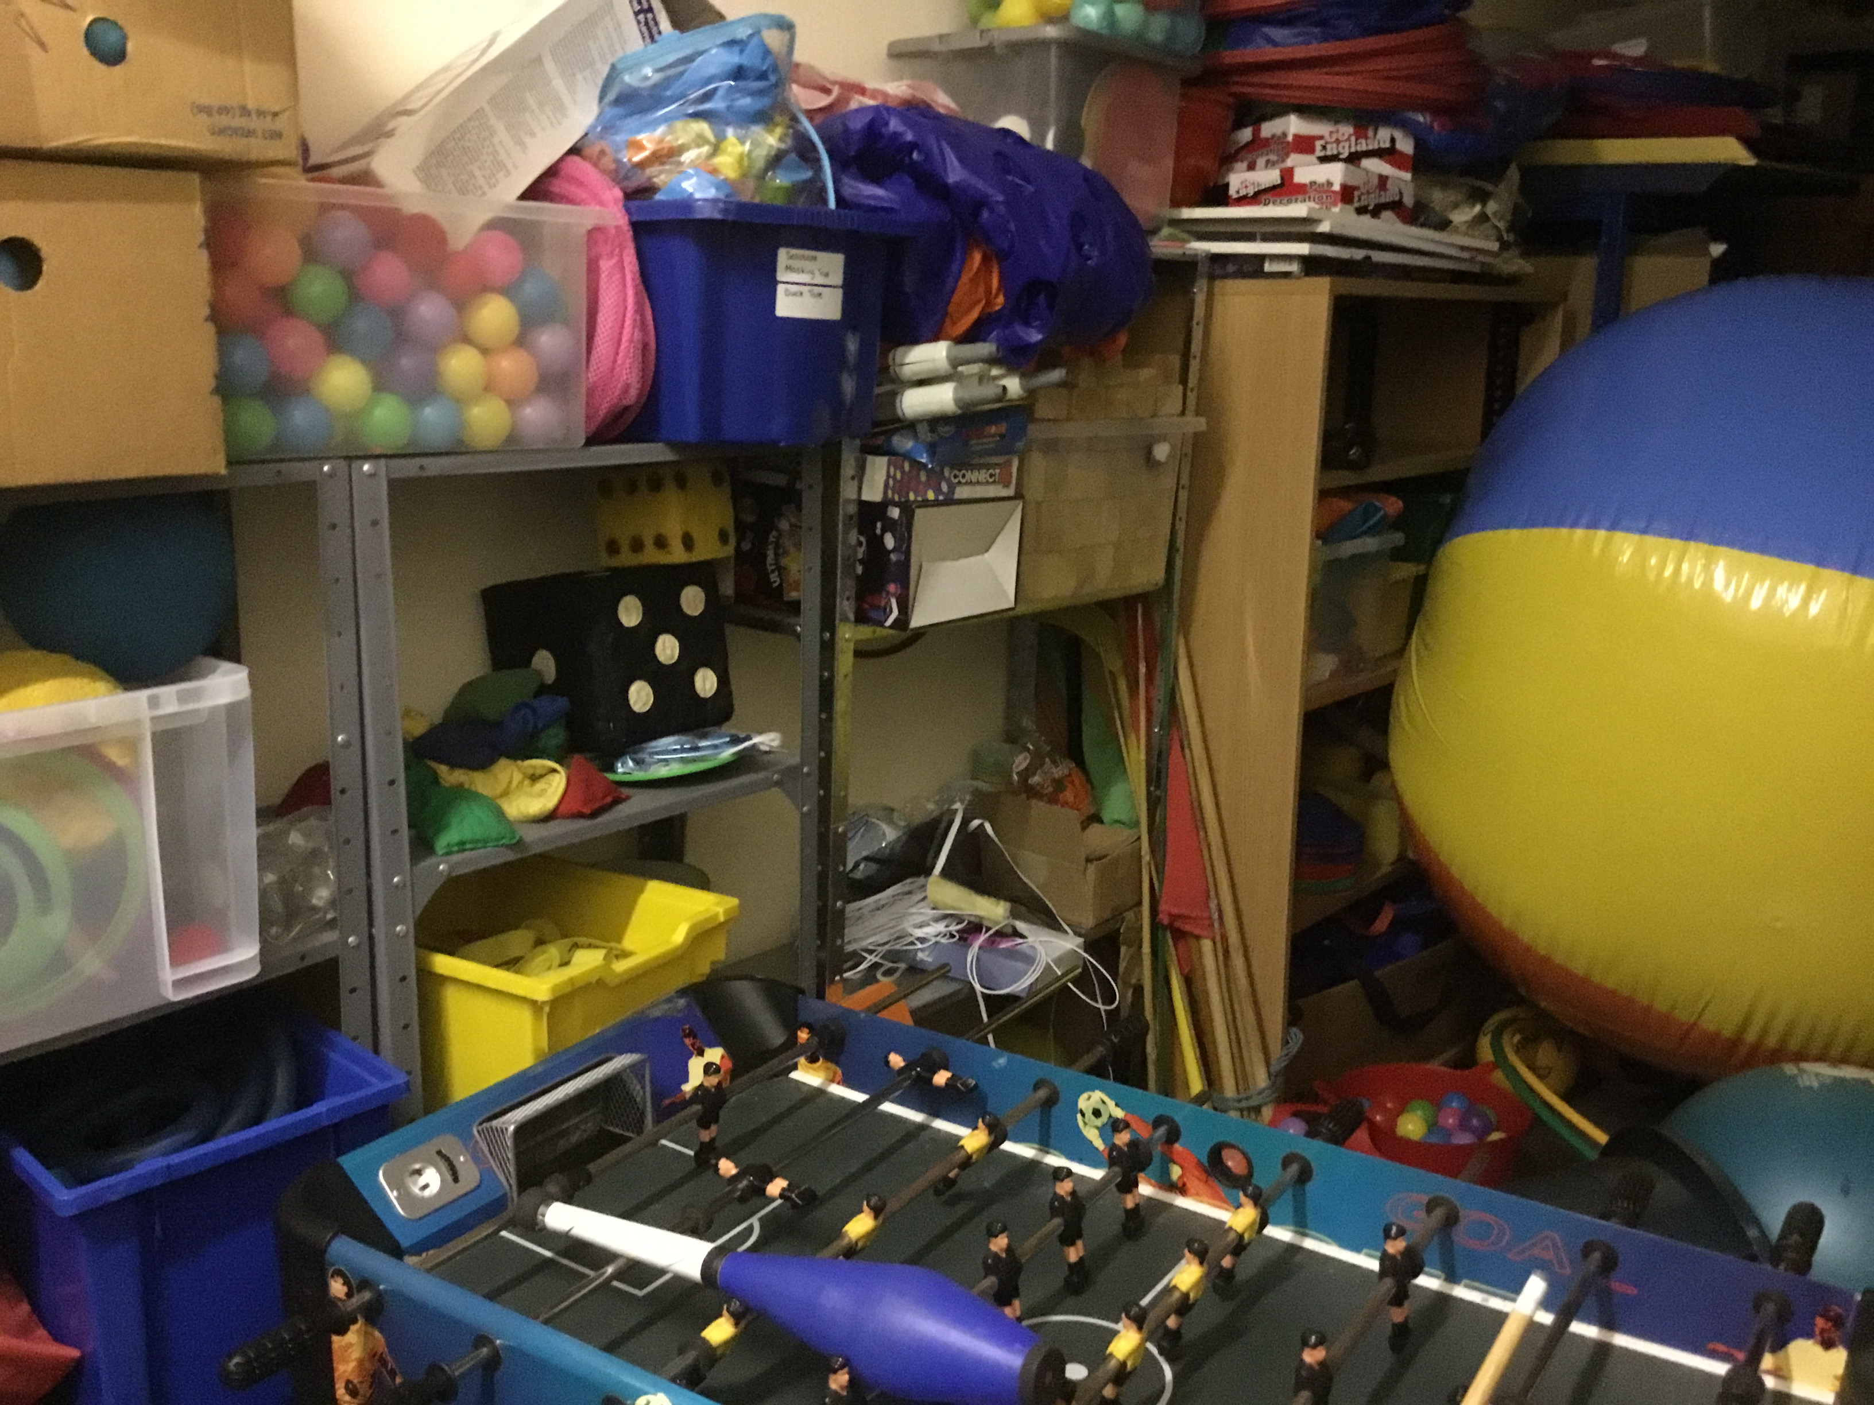
Budget and materials

Slide 17
So what’s actually involved? Continued …
Setting up the room and Praying with the team
Allergies and additional needs – Sweets, Drinks and biscuits
Registration – guide is available
https://www.harrogate-mcc.com/wp-content/uploads/2023/06/Instructions-for-Children-and-Youth-check-in-V5-in-class-with-Tablets-3.pdf
Fire Evacuation Process
https://www.harrogate-mcc.com/wp-content/uploads/2023/06/Fire-Evacuation-Instructions-for-Ministry-Leads-May-23-1.pdf

Slide 18
Toileting
Should avoid taking a child into the toilet on your own.
Take them to the door – make sure you are visible outside the toilet
Make sure hands are washed
Ask parents to take them to the toilet before the session starts

Slide 19
Discipline
All team members need to know and understand the agreed discipline policy in order to present a united, consistent and fair front!
The preferred method of control is by positive reinforcement of good behaviour.
Expected behaviour should be emphasised repeatedly each week if necessary.
Using Team points - reward good individual behaviour, team spirit and co-operation, with prizes to be earned for the winning team at the end of the week, thereby encouraging a sense of healthy competition between teams.
Everyone should be seen to demonstrate a firm but fair approach when dealing with individuals. Getting alongside a child and befriending is far more effective than confrontation.
Threats should be made with extreme caution! Be prepared to keep any threats you make and ensure you have the authority to make them in the first place!
Unacceptable behaviour, i.e. behaviour not conforming to the emphasised expected behaviour highlighted above, should not be tolerated. For example, if quiet is requested you should not commence speaking until the children are quiet.

Slide 20
Discipline Continued …
If unacceptable behaviour persists:
Reinforcement of any good behaviour by the child or children in the vicinity should be exercised as an example;
2. Personal, realistic targets should be set which can be achieved in a short period of time, and rewarded immediately with a suitable number of team points;
3. Children should not be sent out of the room to a location where they will be alone. Workers should not accompany a child out of the room if they will find themselves alone with the child;
4. Banning from the following week’s meeting should only be done by the overall Leader after referral from a team member, and should be considered the ‘very last resort’.
Under no circumstances should the overall Leader or team member hit a child. If you feel you are losing your temper, hand the situation over to another team member. Physical restraint may only be used under law to stop a child injuring themselves or others (please see the church’s Child Protection Policy for more information on this subject).

Slide 21
Elements – Story
Lots of ways to tell a story (all require time and planning)
Pictures, Drama, Reading from the bible, other visual aids (props) etc.
Straight story telling
Interactive story telling involving the children
Play – acting out story with other helpers
Personal resource :-
Voice - tone, pauses, emphasis, sound effects, speed, volume etc
Your face – surprise, anger, sadness, happiness etc
Eyes – eye contact with the children
Hands and body movements
Whilst preparing get to know :-
Your main application for telling the story
Where is the story in the bible
Who wrote it and for whom
Where and when did it happen
What did the characters do

Slide 22
Elements – quiz
The ‘Quiz’ Purpose?
To reinforce the main teaching point of the day whilst having fun!
What’s Involved?
Most of your effort should go into thinking about how best to communicate the application for the day.
Who Does What?
Everyone on the team should be involved in some way, both in preparation and on the day - the team can decide amongst themselves who does what. It’s best to nominate one person as the team captain to ensure somebody takes responsibility for the team getting things done!
What Should It Be Like?
Extremely visual, stimulating, dynamic and fun! As a starting point, try to think of it as the Ultimate TV Game Show!
How Should The Scoring Work?
The quiz game itself can have any points structure you like, as long as it is fair. Random scoring is good as long as it’s fair.
How Long Should It Take? A maximum of five to ten minutes.

Slide 23
Elements – Memory verse
The ‘Memory Verse’ Purpose?
To teach a verse from the Bible that reinforces the main teaching point of the day or helps the child.
What’s Involved?
Fun approaches including sketches and other stimulating ways of getting the Bible verse into the children’s long-term memory need to be thought up. Children may need a copy of the verse in a form that can be taken home.
What Should It Be Like?
Extremely visual, stimulating, dynamic and fun! You could use music, lights, drama, PowerPoint or anything else you can think of. Youtube and google have some great ideas.
How Long Should It Take?
A maximum of five to ten minutes.

Slide 24
Elements – Songs
Try to choose songs which have some connection with the theme (difficult I know). Aim for one song at the start, one at the end and maybe one in the middle. Remember, littlies need songs which are simple to sing and don't take too much reading ability for them to be able to join in.
Remember to use actions
Have fun!
MCC have a USB with well known songs on.

Slide 25
Elements – Games
Safety
Age appropriate
Additional needs
Equipment needed
Space needed
Numbers – some games work better with smaller/larger numbers
Games where someone is out – encourage them / give them something to watch etc
Game ideas (Additional slide at the end)
https://www.harrogate-mcc.com/wp-content/uploads/2021/10/Game-Ideas.pdf
Use Google

Slide 26
Elements – crafts
The ‘Crafts’ Purpose?
To provide an opportunity to sit and chat with the children.
2) To make a simple, theme-related craft each day, which can be taken home.
What’s Involved?
Preparation, planning the Crafts, sourcing any equipment that may be necessary for it.
ALWAYS do a sample craft at home. What looks easy sometimes isn’t!
What Should It Be Like?
Fun to do, but not complicated (age appropriate!). It could involve a fun activity sheet with the memory verse on it or anything else which doesn’t demand full mental attention! Remember, the 1st purpose of this is to sit & chat, not to be totally focussed on creating a masterpiece!
How Long Should It Take?
A maximum of twenty minutes.

Slide 27

Example Pebbles morning. Approx 10-14 children. (Age 3 to school year 1)
Pebbles use the Bubbles Scripture Union leader’s manual. This gives a very comprehensive breadth of material to choose from and plan week by week, throughout the year. The Pebbles room will have been set up by the leader and first helper from about 9.30am onwards.
10.30am; session will start with registration and short welcome as children gather on the carpet. A typical session should include the following:
10. 35am; songs/music, a game, bible story, and prayer. [Remember at this age children have a short attention span so all activities on the carpet should be short, fun, and interactive].
10.45am; craft activity.
11.00am; free choosing. Free choosing is a time for the children to play with the various toys and materials in the room and socialize with other children.
11.15am; refreshments (water, biscuit, or raisins).
11.25, further choosing time.
11.35 (approx.). Parents will come to collect their children at the end of the church service. No child is allowed to leave the room without their parent or carer collecting them.
We normally have 3 adults in the room every Sunday, a leader and two helpers.

Slide 28

Example Gems morning. Approx 12-20 children (School years 2-3)
Registration 5 mins
Introduction to theme -game or song (or both) 10 mins
Story / video 10 mins
Discussion/prayer time 5 mins
Drink and snack 5 mins
Quiz or game 10 mins
Craft 15 mins
Free play until parents collect 10 mins

Slide 29
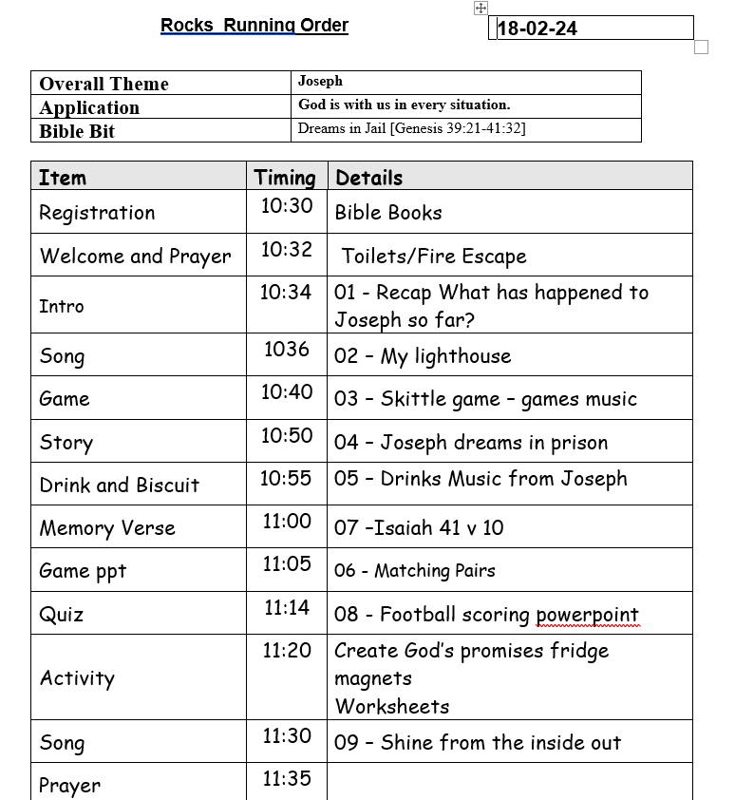

Example Rocks morning. Approx 14-23 children (School years 4-6)
The Side hall will have been set up by the leader from about 9.20am onwards.
Don’t forget drinks and biscuits.
Don’t forget games equipment needed and test out the AV if using it.
Reward the class with one sweet at the end. Winning Quiz team get to choose first!

Slide 30
Four types of special educational need
Cognition and learning (C and L)
The child may:
learn at a slower pace than others their age
find it difficult to understanding some lessons or subjects
struggle with organisation and memory skills
have a specific difficulty affecting one particular part of their learning performance such as in literacy or numeracy

Slide 31
Four types of special educational need
Cognition and learning (C and L)
The child may:
learn at a slower pace than others their age
find it difficult to understanding some lessons or subjects
struggle with organisation and memory skills
have a specific difficulty affecting one particular part of their learning performance such as in literacy or numeracy
Communication and interaction (C and I)
The child may:
find it difficult to understand and process language
struggle with the use of spoken language or nonverbal communication
have difficulties with social interaction
have speech sound difficulties

Slide 32
Four types of special educational need
Cognition and learning (C and L)
The child may:
learn at a slower pace than others their age
find it difficult to understanding some lessons or subjects
struggle with organisation and memory skills
have a specific difficulty affecting one particular part of their learning performance such as in literacy or numeracy
Communication and interaction (C and I)
The child may:
find it difficult to understand and process language
struggle with the use of spoken language or nonverbal communication
have difficulties with social interaction
have speech sound difficulties
Social, emotional and mental health difficulties (SEMH)
The child may:
find it difficult to understand and manage their own feelings
feel withdrawn or unhappy
struggle to manage relationships with others
find it challenging to follow instructions
may struggle with my behaviour

Slide 33
Four types of special educational need
Cognition and learning (C and L)
The child may:
learn at a slower pace than others their age
find it difficult to understanding some lessons or subjects
struggle with organisation and memory skills
have a specific difficulty affecting one particular part of their learning performance such as in literacy or numeracy
Communication and interaction (C and I)
The child may:
find it difficult to understand and process language
struggle with the use of spoken language or nonverbal communication
have difficulties with social interaction
have speech sound difficulties
Social, emotional and mental health difficulties (SEMH)
The child may:
find it difficult to understand and manage their own feelings
feel withdrawn or unhappy
struggle to manage relationships with others
find it challenging to follow instructions
may struggle with my behaviour
Sensory and/or physical needs
The child may have a:
hearing loss ranging from mild to profound
visual impairment ranging from mild to profound
multi-sensory impairment of both hearing and visual loss
sensory processing difficulty
physical difficulty that requires additional ongoing support and equipment

Slide 34
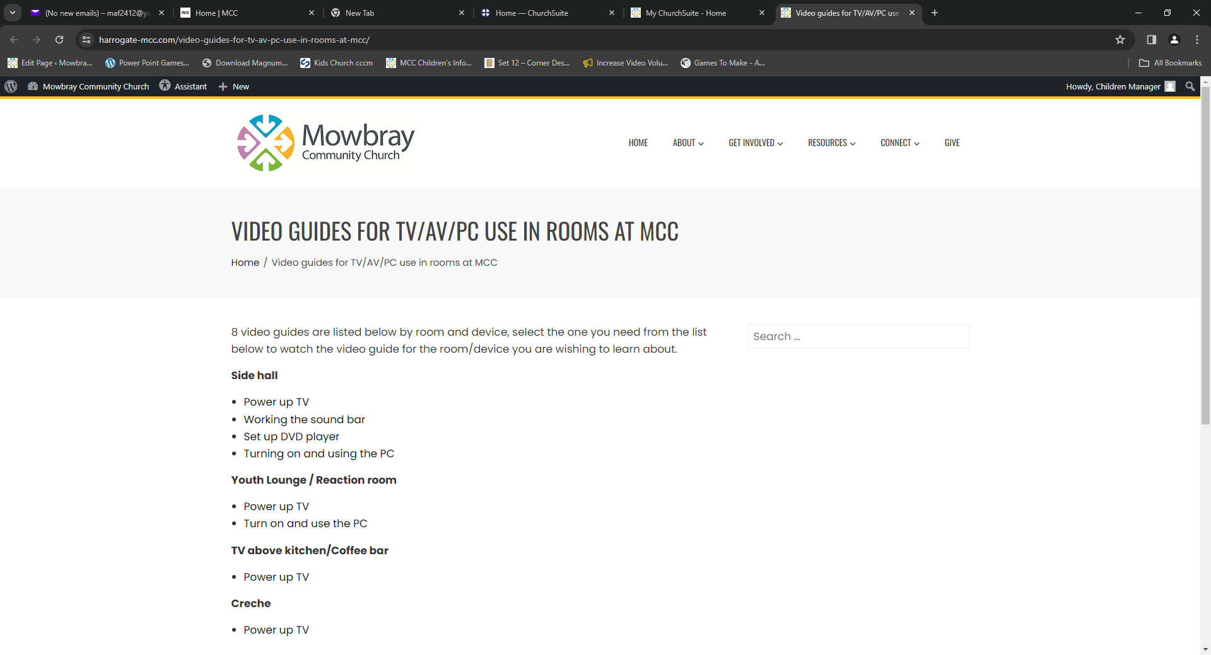
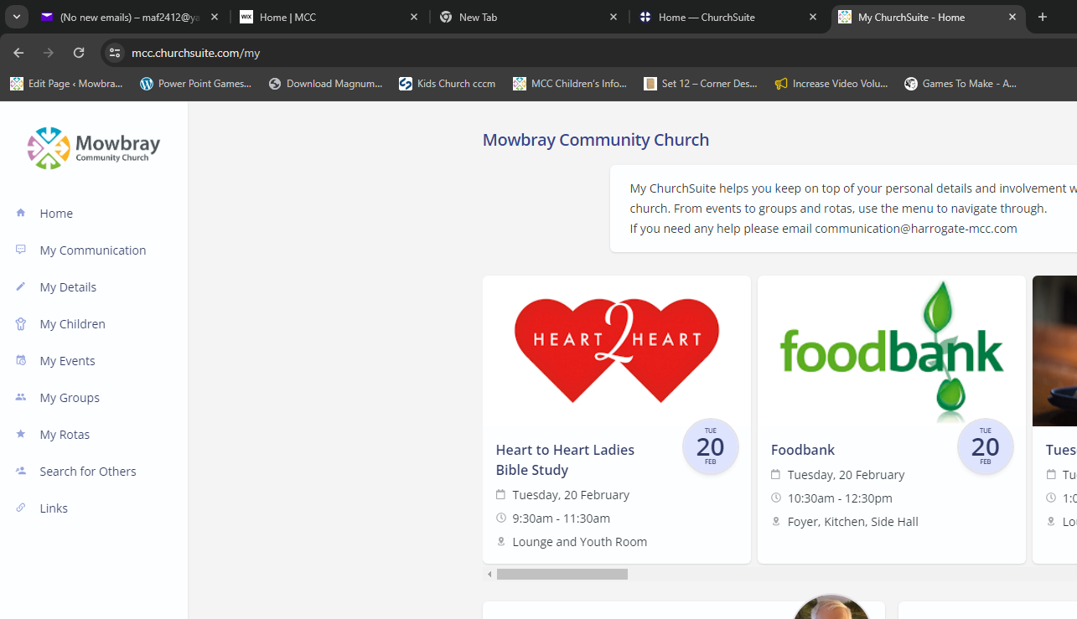
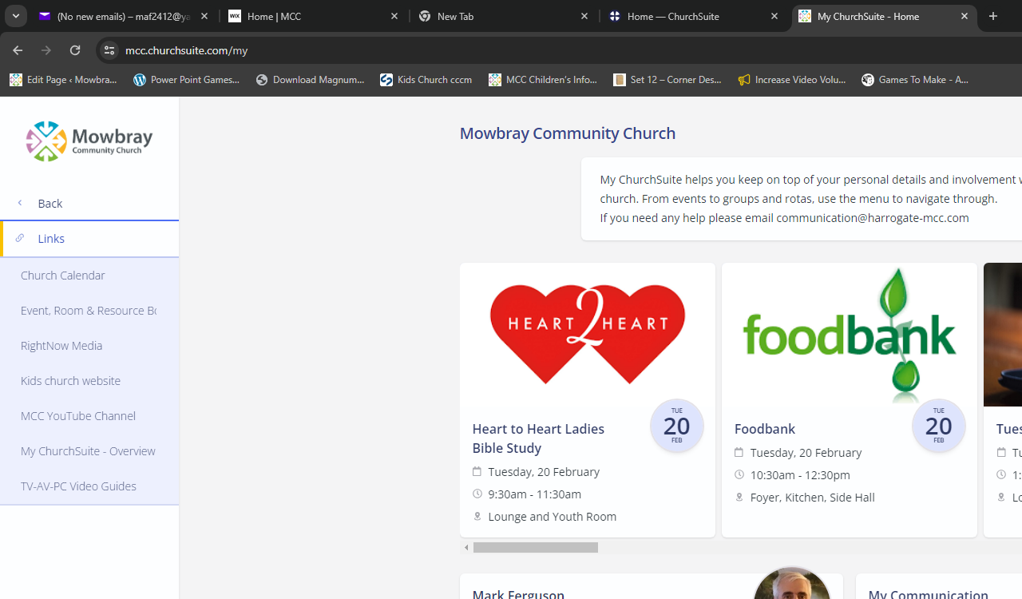
AV Setup

Slide 35



Slide 36
Quick simple games
Heads and Tails
Islands
Hot potato
Rock, Paper, Scissors
Choose a colour/corner
Duck, Duck Goose.
In the River on the bank
Simon says
Musical chairs
Balloon tennis
Hangman / Flower
I spy
20 questions – what am I?
Musical statues
Musical Bus
Charades
Chinese laundry
Stuck in the mud

Slide 37










Slide 38


Slide 39


Slide 40


Slide 41


Slide 42


Slide 43
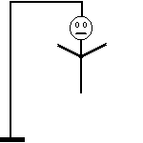

Slide 44


Slide 45
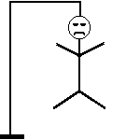
Mark Wins

Slide 46












3 Points
2 Points
3 Points
1 Point
3 Points
2 Points
2 Points
3 Points
3 Points
2 Points
3 Points
1 Point

Slide 47
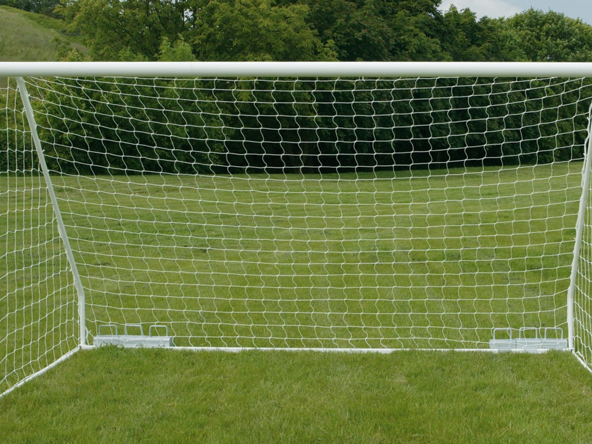



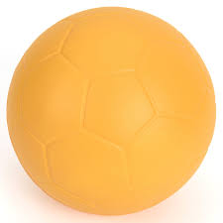


Points
A
B
C
D
E
F
G
H
I
J
K
L
M
N
O
P
Q
R
S
T

